Slide 1
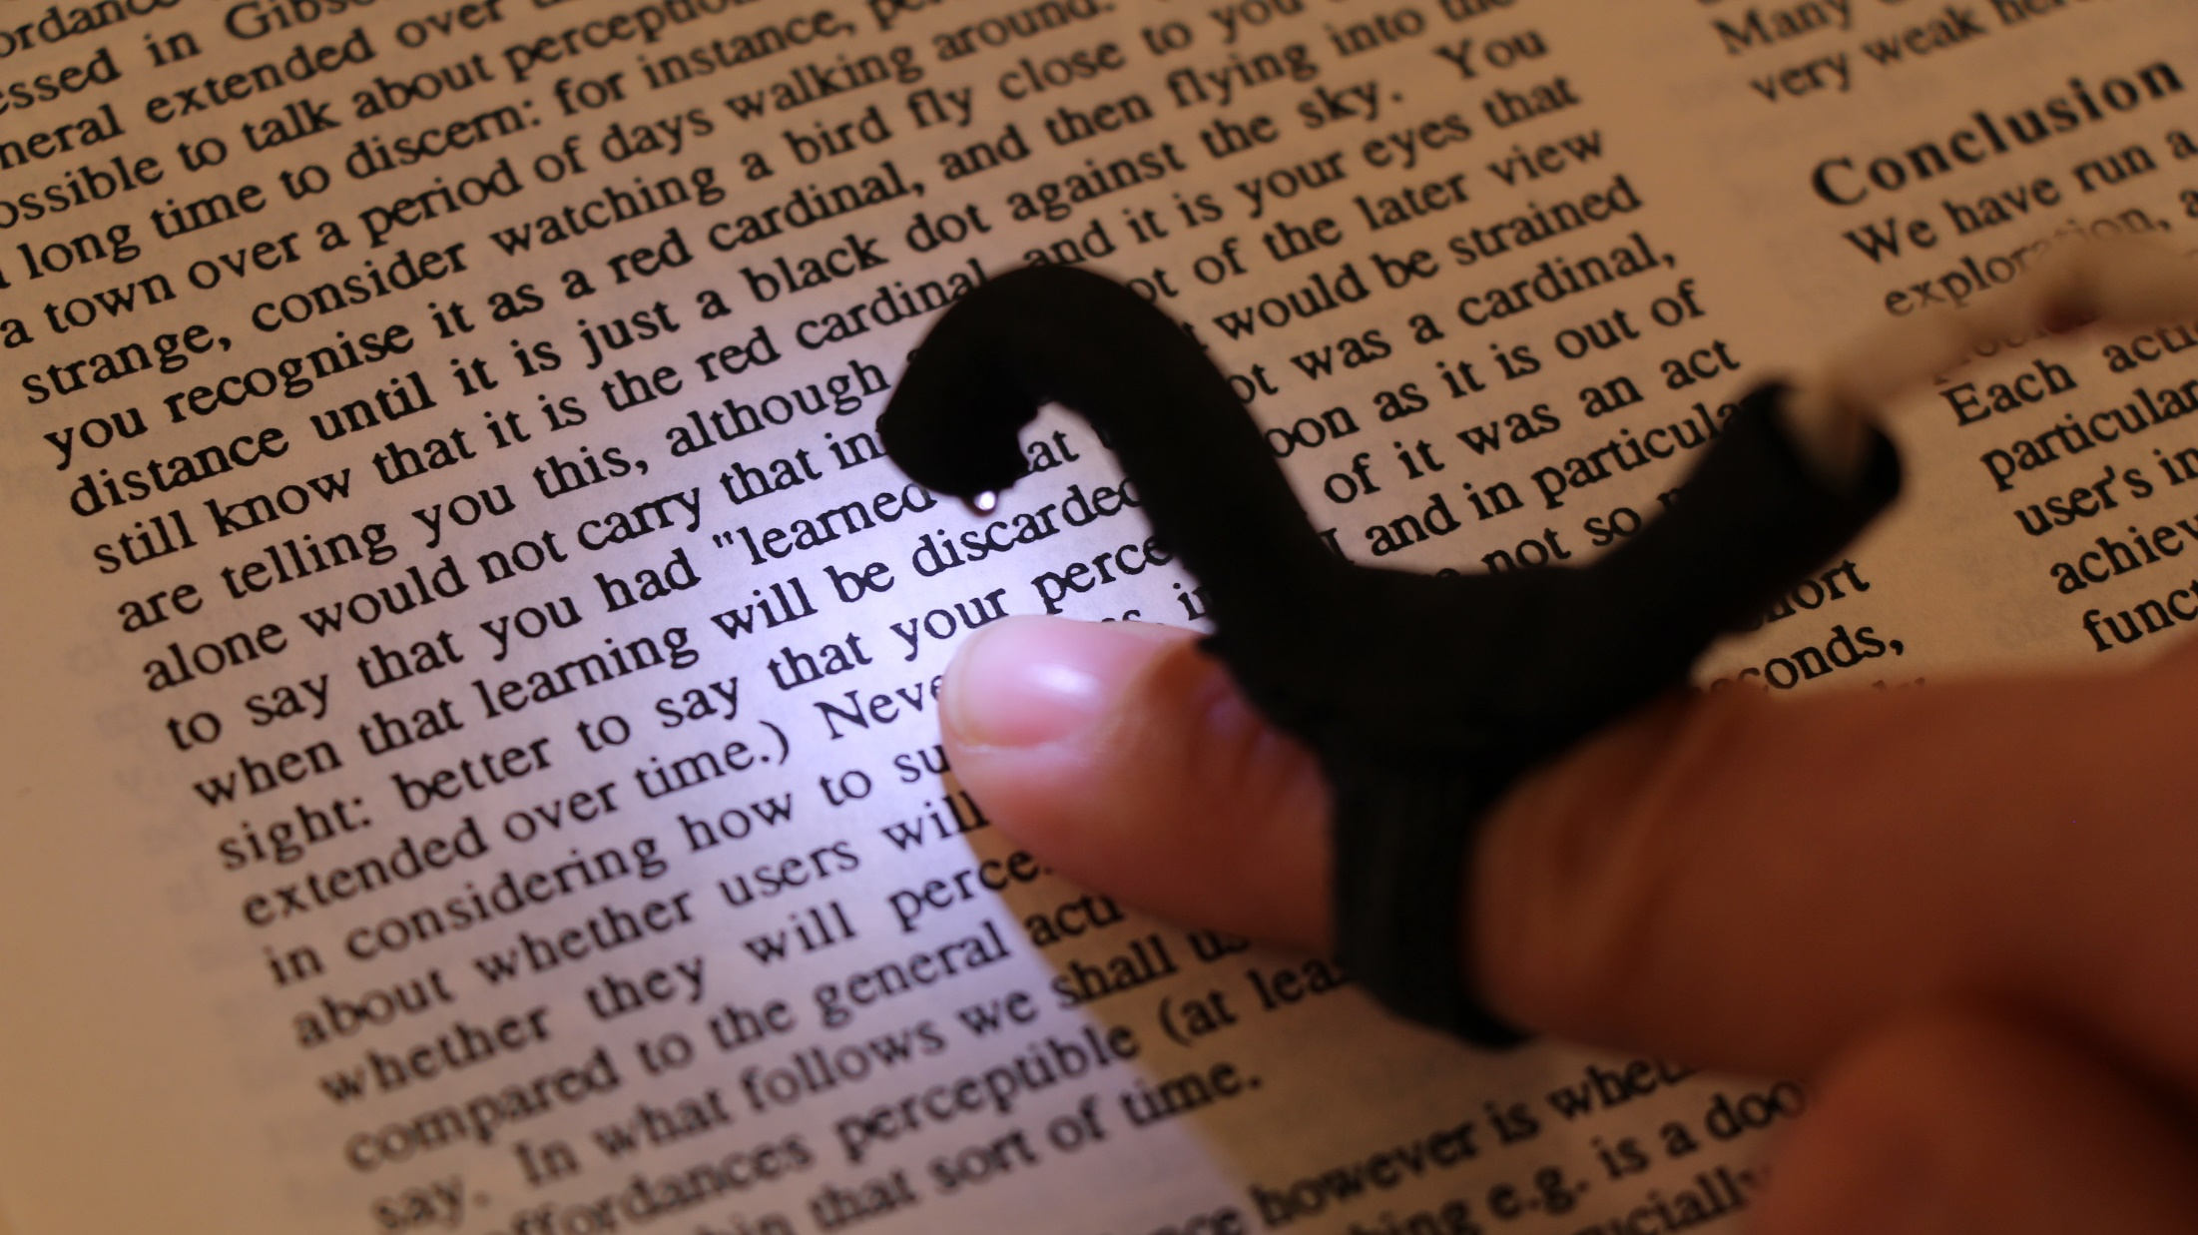
Evaluating Haptic and Auditory Guidance to Assist Blind People in Reading Printed Text Using Finger-Mounted Cameras
TACCESS | ASSETS 2016
Lee Stearns¹, Ruofei Du¹, Uran Oh¹, Catherine Jou¹, Leah Findlater², David A. Ross³, Jon E. Froehlich¹
University of Maryland: Computer Science¹, Information Studies², Atlanta VA R&D Center for Visual & Neurocognitive Rehabilitation³
Notes:
Hello everyone! My name is Lee Stearns and I’m from the University of Maryland. Today I’m going to be presenting my group’s research, titled “Evaluating Haptic and Auditory Guidance to Assist Blind People in Reading Printed Text Using Finger-Mounted Cameras”.

Slide 2
What if printed text could be accessed
through touch in the same way as braille?
*Video Credit: YouTube—Ginny Owens—How I See It (Reading Braille)
Notes:
We began this project with a question: what if printed text could be accessed through touch in the same way as braille? Touch-based reading is a highly tactile experience that enables easy exploration of spatial layouts and direct control over reading speed or order.

Slide 3
What if printed text could be accessed
through touch in the same way as braille?
Notes:
But relatively little material is available in Braille, and even with the increasing availability of digital information and screen reader software, reading printed text materials is still an important but challenging task for people with visual impairments.

Slide 4
What if printed text could be accessed
through touch in the same way as braille?
Reading printed materials is still an important but challenging task for people with visual impairments
Notes:
But relatively little material is available in Braille, and even with the increasing availability of digital information and screen reader software, reading printed text materials is still an important but challenging task for people with visual impairments.

Slide 5
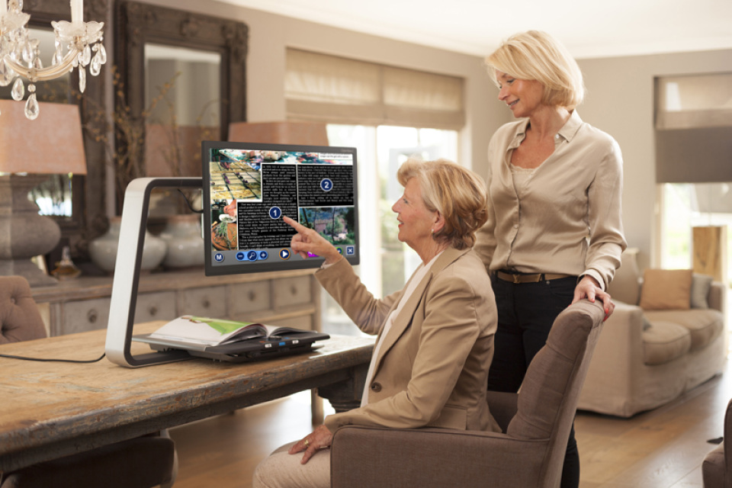
Popular Reading Devices
Notes:
We looked at several existing devices that offer reading solutions,

Slide 6
Popular Reading Devices
Scanner | OCR | Screen Reader
Notes:
from stationary scanners and screen reader software [next slide]
to dedicated devices such as desktop video magnifiers, [next slide]
to mobile phone applications like KNFB Reader [next slide]
and more recently to wearable cameras such as OrCam.

Slide 7
Popular Reading Devices
Dedicated devices (e.g., video magnifiers)
Notes:
from stationary scanners and screen reader software [next slide]
to dedicated devices such as desktop video magnifiers, [next slide]
to mobile phone applications like KNFB Reader [next slide]
and more recently to wearable cameras such as OrCam.

Slide 8
Popular Reading Devices
Smartphone apps (e.g., KNFB Reader iOS)
Notes:
from stationary scanners and screen reader software [next slide]
to dedicated devices such as desktop video magnifiers, [next slide]
to mobile phone applications like KNFB Reader [next slide]
and more recently to wearable cameras such as OrCam.

Slide 9
Popular Reading Devices
Wearable Cameras (e.g., OrCam)
Notes:
from stationary scanners and screen reader software [next slide]
to dedicated devices such as desktop video magnifiers, [next slide]
to mobile phone applications like KNFB Reader [next slide]
and more recently to wearable cameras such as OrCam.

Slide 10
Popular Reading Devices
Scanner | OCR | Screen Reader
Dedicated Devices (e.g., video magifiers)
Smartphone Apps (e.g., KNFB Reader iOS)
Wearable Cameras (e.g., OrCam)
Notes:
These devices have gone a long way toward improving the accessibility of printed materials, but several open questions still remain.

Slide 11
Open Questions (Existing Devices)
How to assist with aiming the camera
to capture desired content?
Notes:
One important question for handheld or wearable devices is how to help with aiming the camera to capture the target content. For example, the KNFB Reader app and OrCam both provide spoken field of view reports to assist with aiming, but the process can still be challenging for blind readers.

Slide 12
Open Questions (Existing Devices)
How to assist with aiming the camera
to capture desired content?
How to handle complex documents
and convey layout information?
Notes:
Another question is how to interpret and communicate documents with complex layouts such as newspapers or menus. Even with digital content it can be difficult to decide the order to read different blocks of text, and what layout details to convey.

Slide 13
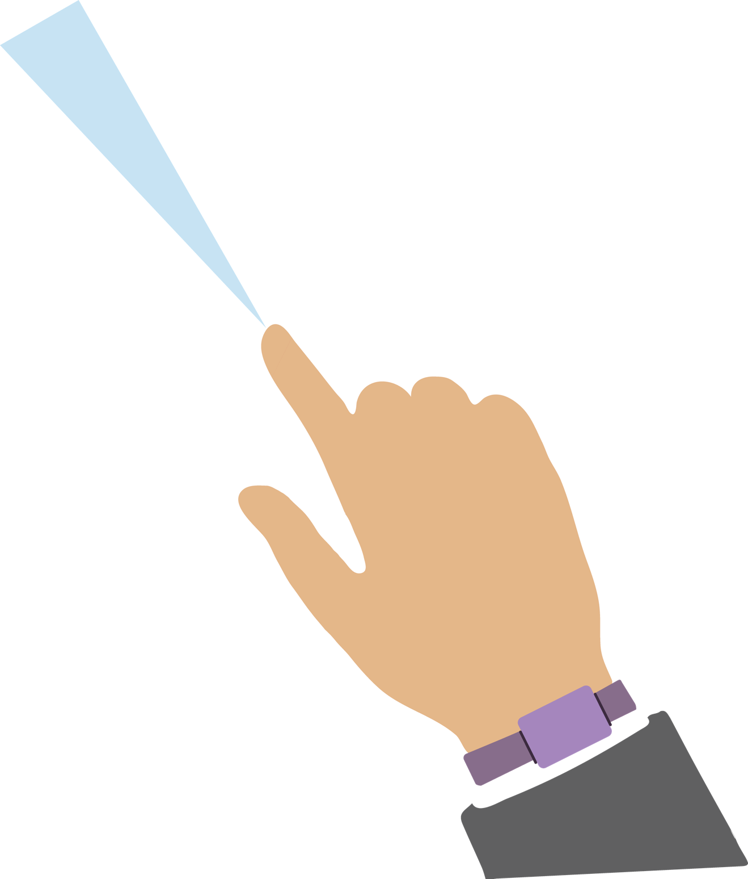
HandSight
A vision-augmented touch system
Notes:
As an alternative to these solutions, we envision a system called HandSight that’s made up of tiny cameras [next slide] and haptics [next slide] integrated directly with the user’s fingers. It would be connected to a smartwatch [next slide] for power, processing, and speech or audio output. [next slide]
We first proposed this idea as a system that augments the sense of touch for several different applications, but our focus so far has primarily been on reading printed text.

Slide 14
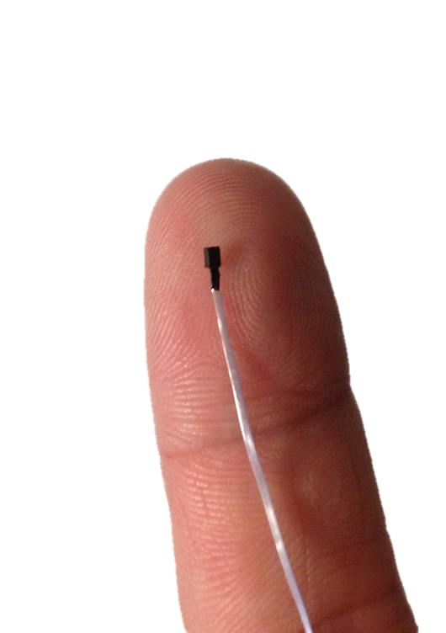
HandSight
A vision-augmented touch system
Tiny CMOS cameras,
Notes:
As an alternative to these solutions, we envision a system called HandSight that’s made up of tiny cameras [next slide] and haptics [next slide] integrated directly with the user’s fingers. It would be connected to a smartwatch [next slide] for power, processing, and speech or audio output. [next slide]
We first proposed this idea as a system that augments the sense of touch for several different applications, but our focus so far has primarily been on reading printed text.

Slide 15
HandSight
A vision-augmented touch system
Tiny CMOS cameras,
haptic actuators mounted
on one or more fingers
Notes:
As an alternative to these solutions, we envision a system called HandSight that’s made up of tiny cameras [next slide] and haptics [next slide] integrated directly with the user’s fingers. It would be connected to a smartwatch [next slide] for power, processing, and speech or audio output. [next slide]
We first proposed this idea as a system that augments the sense of touch for several different applications, but our focus so far has primarily been on reading printed text.

Slide 16
HandSight
A vision-augmented touch system
Tiny CMOS cameras,
haptic actuators mounted
on one or more fingers
Smartwatch for power,
processing, speech
and audio output
Notes:
As an alternative to these solutions, we envision a system called HandSight that’s made up of tiny cameras [next slide] and haptics [next slide] integrated directly with the user’s fingers. It would be connected to a smartwatch [next slide] for power, processing, and speech or audio output. [next slide]
We first proposed this idea as a system that augments the sense of touch for several different applications, but our focus so far has primarily been on reading printed text.

Slide 17
HandSight
A vision-augmented touch system
* Originally proposed in Stearns et al. 2014
Tiny CMOS cameras,
haptic actuators mounted
on one or more fingers
Smartwatch for power,
processing, speech
and audio output
Notes:
As an alternative to these solutions, we envision a system called HandSight that’s made up of tiny cameras [next slide] and haptics [next slide] integrated directly with the user’s fingers. It would be connected to a smartwatch [next slide] for power, processing, and speech or audio output. [next slide]
We first proposed this idea as a system that augments the sense of touch for several different applications, but our focus so far has primarily been on reading printed text.

Slide 18
Augmenting the User’s Finger
Survey: Digital Digits (Shilkrot et al. 2015)
Notes:
The idea of augmenting the user’s finger has become more and more common in recent years. There’s a survey paper called Digital Digits that gives a good overview, but today I’m only going to mention two projects that are particularly relevant to our research.

Slide 19
Augmenting the User’s Finger
Magic Finger (Yang et al. 2012)
Camera & Optical Mouse Sensor
Notes:
The first is Magic Finger, which combined a small camera with an optical mouse sensor at the tip of the user’s finger to recognize gestures on any surface.

Slide 20
Augmenting the User’s Finger
FingerReader (Shilkrot et al. 2014, 2015)
Camera and
Vibration Motor
Notes:
And more specifically related to our goal of reading printed materials is FingerReader, which explored using a ring-based camera with haptic and audio feedback. It allowed blind readers to trace their finger over printed text and hear speech output in real-time.

Slide 21
Augmenting the User’s Finger
HandSight (Stearns et al. 2014)
Vibration Motors
Processing+Power
Camera
Notes:
Our own previous research explored a similar solution. We used a ring design with the same tiny camera as Magic Finger, along with a pair of vibration motors to provide haptic feedback.

Slide 22
Advantages of Finger-Based Reading
Does not require framing an overhead camera
Notes:
Reading by touch has several potential advantages. It enables direct access—you place your finger on the page, and you can immediately start getting feedback and exploring the document. You don’t need to worry about lining up the document with the camera or waiting for it to be scanned and processed.

Slide 23
Advantages of Finger-Based Reading
Does not require framing an overhead camera
Allows direct access to spatial information
Notes:
It may also provide a more intuitive way for users to explore a document’s layout, which we hope could improve comprehension and document understanding, especially for more complex documents.

Slide 24
Advantages of Finger-Based Reading
Does not require framing an overhead camera
Allows direct access to spatial information
Provides better control over pace and rereading
Notes:
And since the system reads words only when the finger moves across them, users have better control over pace and rereading.

Slide 25
Advantages of Finger-Based Reading
Does not require framing an overhead camera
Allows direct access to spatial information
Provides better control over pace and rereading
Notes:
But a finger-based approach also introduces some new challenges that haven’t been fully investigated.

Slide 26
Advantages of Finger-Based Reading
Does not require framing an overhead camera
Allows direct access to spatial information
Provides better control over pace and rereading
New Challenges
How to precisely trace a line of text?
How to support physical navigation?
Notes:
But a finger-based approach also introduces some new challenges that haven’t been fully investigated.
Because the field of view from a finger-mounted camera is limited, the reader has to precisely trace their finger along the current line of text so that the image doesn’t get cut off or distorted. We’ll also need to assist users in physical navigation through the document, such as finding the start of a passage and moving from one line to the next.
To overcome these two challenges we’ll need to be able to effectively guide the user’s finger.

Slide 27
Comparing Two Types of Directional Finger Guidance
2. Audio via built-in
or external speakers
1. Finger-mounted
vibration motors
Notes:
We compared two types of guidance to see which would better enable blind readers to trace lines of text and read a document: haptic or audio.

Slide 28
Comparing Two Types of Directional Finger Guidance
1. Finger-mounted
vibration motors
Notes:
First was the haptic directional guidance, which used a pair of vibration motors mounted on the top and bottom of the user’s finger. These conveyed direction and distance by the position and intensity of the vibration.

Slide 29
Comparing Two Types of Directional Finger Guidance
Move up
1. Finger-mounted
vibration motors
Notes:
The upper motor directed participants to move upwards,

Slide 30
Comparing Two Types of Directional Finger Guidance
1. Finger-mounted
vibration motors
Move down
Notes:
and the lower motor directed them downwards.

Slide 31
Comparing Two Types of Directional Finger Guidance
2. Audio via built-in
or external speakers
Notes:
Second was audio directional guidance, which used a continuous tone with a variable pitch to convey direction and distance.

Slide 32
Comparing Two Types of Directional Finger Guidance
2. Audio via built-in
or external speakers
Higher pitch: move up
Notes:
In this case a higher pitch directed participants upward

Slide 33
Comparing Two Types of Directional Finger Guidance
2. Audio via built-in
or external speakers
Lower pitch: move down
Notes:
and a lower pitch directed them downward.

Slide 34
Research Questions
To what extent are finger-based cameras a viable accessibility solution for reading printed text?
What design choices can improve this viability?
Notes:
Our research was the first to take a detailed look at the directional guidance and general usability of reading with a finger-mounted camera quantitatively as well as subjectively.
The main questions driving our research were to learn to what extent finger-based cameras are a viable accessibility solution for reading printed text? And also what design choices could improve that viability?

Slide 35
Study Overview
Study I: initial iPad study (19 participants)
Study II: physical prototype study (4 participants)
Notes:
We conducted two studies to further investigate this idea. The first was a controlled lab experiment with 19 participants, which looked at the user experience of reading through touch and specifically compared the two types of directional finger guidance. The second was a smaller follow-up study with 4 participants, which collected preliminary feedback about our wearable prototype.

Slide 36
Study Overview
Study I: initial iPad study (19 participants)
Study II: physical prototype study (4 participants)
Notes:
The primary goal of the first study was to compare audio and haptic directional finger guidance in terms of user performance and preference. But we also explored the extent that our approach would allow a blind reader to interpret the spatial layout of a document and to read and understand that document.

Slide 37
Study Overview
Study Overview
Goals:
Compare audio/haptic
Explore & interpret spatial layouts
Assess reading and comprehension
Study I: initial iPad study (19 participants)
Study I: initial iPad study (19 participants)
Notes:
The primary goal of the first study was to compare audio and haptic directional finger guidance in terms of user performance and preference. But we also explored the extent that our approach would allow a blind reader to interpret the spatial layout of a document and to read and understand that document.

Slide 38
Study I Method
Used an iPad to focus on user experience, gather finger trace data
Notes:
We used an iPad covered with a thin sheet of paper to simulate the experience of reading a physical document. That let us bypass some of the technical challenges and instead focus just on the user experience. It also allowed us to collect precise finger trace data to perform detailed analysis of finger movements.

Slide 39
Study I Method
Used an iPad to focus on user experience, gather finger trace data
19 participants
Median Age | 48 (SD=12, Range=26-67)
Gender | 11 Male, 8 Female
Vision Level | 10 Totally Blind, 9 Light Sensitive
Notes:
We recruited 19 participants, all of whom were totally blind or with only minimal light perception.

Slide 40
Study I Method
Used an iPad to focus on user experience, gather finger trace data
19 participants
Within-subjects, two guidance
conditions: audio and haptic
Audio pitch
Haptic vibrations
Notes:
We used a within-subjects experiment design with 2 directional guidance conditions: audio and haptic. The conditions were identical aside from the type of directional guidance that was provided while the participant was tracing a line of text or searching for the start of the next line.

Slide 41
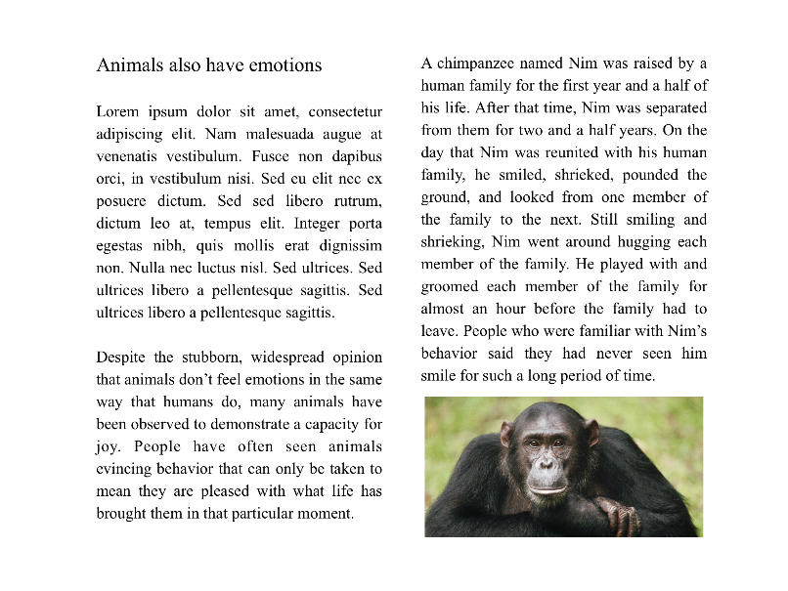
Study I Method
Used an iPad to focus on user experience, gather finger trace data
19 participants
Within-subjects, two guidance conditions: audio and haptic
Participants read two documents for each condition
plain
magazine
Notes:
We asked each participant to read 2 documents for each condition, a plain text document and a magazine-style document that had two columns, a title, and an image.

Slide 42
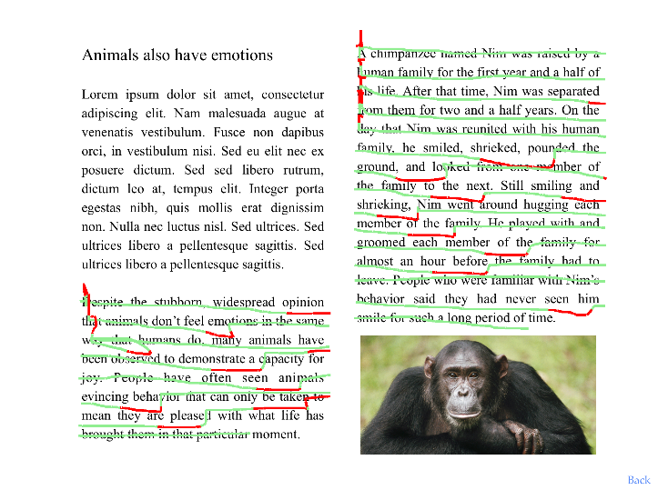
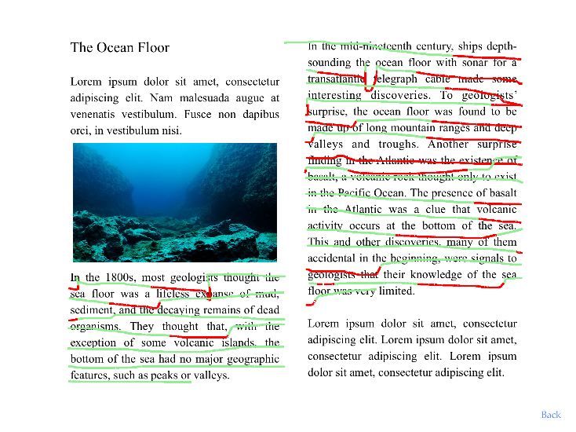
Study I Method
Used an iPad to focus on user experience,
gather finger trace data
19 participants
Within-subject, two guidance
conditions: audio and haptic
Participants read two documents for each condition
Analysis: reading speed and accuracy, comprehension, subjective feedback
audio
haptic
Notes:
We collected statistics on the participants’ reading speed and accuracy, their comprehension of each document, and subjective feedback about the ease of use. We used all of that information to compare the two guidance conditions and to evaluate the overall usability of our interface.

Slide 43
System Design: Exploration and Reading Modes
Exploration Mode
Reading Mode
Notes:
Our system had 2 modes: exploration mode and reading mode. For each document, participants first explored to learn its layout and find the first line of text, and then read sequentially through the selected passage.

Slide 44
System Design: Exploration Mode
Continuous audio feedback to identify content beneath finger
Flute sound: text
Cello sound: picture
Silence: empty space
Same across both conditions
Notes:
In the exploration mode, the participant could move around the page however they liked, and the system provided continuous audio feedback to identify the content that was underneath their finger. We chose distinctive high and low pitched sounds to represent text or pictures, and silence to represent empty space. The exploration mode was the same across both conditions.
I’m now going to play a video demo of that interface.

Slide 45
Silence: empty space
Flute sound: text
Cello sound: picture
Notes:
[play video]

Slide 46
System Design: Reading Mode
Bimanual: right index finger to read, left to anchor start of line
Directional guidance: audio or haptic depending on condition
Used to stay on the line or find the start of the next line
Audio: pitch of continuous audio
Haptic: strength and position of vibration
Additional audio cues (same for both conditions)
Start/end of line or paragraph
Synthesized speech
Notes:
In the reading mode, participants moved sequentially along each line and the system read each word out loud as their finger passed over it. They could use their right index finger to read and their left as an anchor to help them find the start of the next line. We provided vertical directional guidance to help stay on a line or to locate the start of a new line.
For the audio condition, continuous audio cues played when the participant’s finger drifted off of the line, and the pitch changed depending the direction and distance to the line. The haptic condition was very similar, but it used the location and intensity of the vibrations in place of the audio pitch. We also played distinctive audio cues to identify the start and end of each line or paragraph, as well as the speech feedback.
Here’s a demo of the reading interface.

Slide 47
Above the line: downward guidance
(low pitch or lower vibration motor)
Start/end of line or paragraph
(short but distinctive audio cues)
Below the line: upward guidance
(high pitch or upper vibration motor)
Notes:
[play video]

Slide 48
Study I Findings
Haptic vs. Audio: Quantitative Performance
Notes:
Our findings highlighted tradeoffs between the two guidance conditions.

Slide 49
Study I Findings
Haptic vs. Audio: Quantitative Performance
Line tracing / magazine documents: Audio significantly more accurate (p = 0.018)
Notes:
The speed and accuracy of the two types of guidance were very similar for both line finding and line tracing, but audio may offer some advantages to accuracy since it was significantly better than haptics while reading the magazine documents.

Slide 50
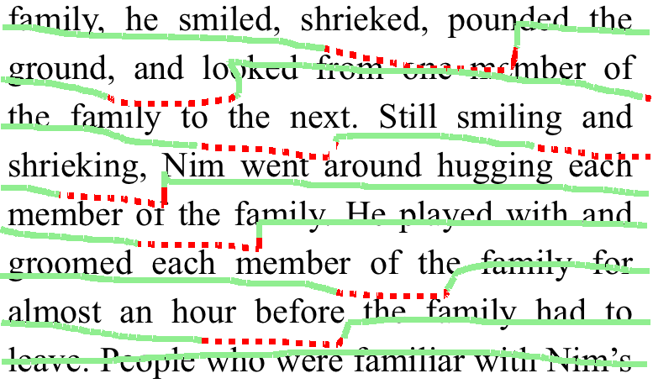
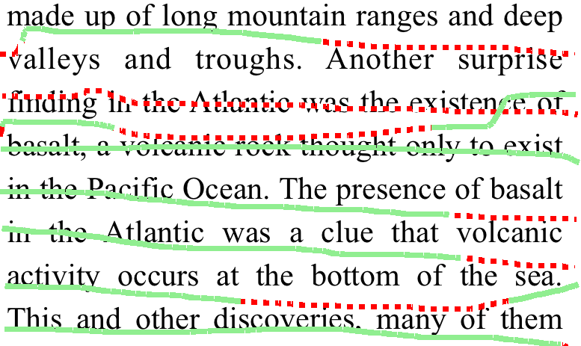
Study I Findings
Haptic vs. Audio: Quantitative Performance
Line tracing / magazine documents: Audio significantly more accurate (p = 0.018)
audio
haptic
Example finger traces—Dashed red lines mark drift off of the line
Notes:
These images show some example finger traces from a single participant. The solid green lines show when the participant was accurately following the line, and dashed red lines show where they were off the line and receiving directional guidance. Audio guidance tended to prompt a more immediate correction than haptic.

Slide 51
Study I Findings
Haptic vs. Audio: Quantitative Performance
Line tracing / magazine documents: Audio significantly more accurate (p = 0.018)
Comprehension high, no significant differences between conditions
audio
haptic
Example finger traces—Dashed red lines mark drift off of the line
Notes:
Comprehension was high across all of the documents, with no significant differences between the two conditions.

Slide 52
Study I Findings
Haptic vs. Audio: Subjective Preference
Preferences split (11 haptic, 7 audio, 1 equal preference)
Notes:
The participants’ preferences were split, although a majority preferred haptic guidance.

Slide 53
Study I Findings
Haptic vs. Audio: Subjective Preference
Preferences split (11 haptic, 7 audio, 1 equal preference)
Preferred Haptic
More intuitive Easier to use Faster Less distracting
Notes:
The participants who preferred haptic felt that it was more intuitive, easier to use, or faster than audio. Some also found the audio guidance more distracting, and said that it made it harder to focus on the speech feedback.

Slide 54
Study I Findings
Haptic vs. Audio: Subjective Preference
Preferences split (11 haptic, 7 audio, 1 equal preference)
Preferred Haptic | Preferred Audio
More intuitive Easier to use Faster Less distracting | Less confusing More comfortable No desensitization
Notes:
On the other hand, almost all of those who preferred audio guidance found it to be less confusing than haptic. Several participants had trouble remembering which direction was indicated by which motor. A few felt that the mapping we used was the reverse of how it should be, and it’s possible that given the option to customize it more would have preferred the haptic guidance.
Two participants were also concerned with the comfort level of the haptic version and the potential for desensitization over time.

Slide 55
Study I Findings
Haptic vs. Audio: Subjective Preference
Preferences split (11 haptic, 7 audio, 1 equal preference)
Preferred Haptic | Preferred Audio
More intuitive Easier to use Faster Less distracting | Less confusing More comfortable No desensitization
Reflects contradictory findings in Stearns et al. 2014, Shilkrot et al. 2014, 2015
Notes:
This split in user preferences reflects the contradictory findings in reported previous studies.

Slide 56
Study I Findings
Overall Reading Experience
Pros
Low learning curve Flexible Direct control over speed
Notes:
In general, several participants liked the lower learning curve and flexibility of our system compared to other reading approaches, and especially the ability to directly control the reading speed.

Slide 57
Study I Findings
Overall Reading Experience
Pros | Cons
Low learning curve Flexible Direct control over speed | Hard to use for reading High cognitive load may affect comprehension
Notes:
However, others raised concerns about ease of use and cognitive load, which could affect comprehension and retention.

Slide 58
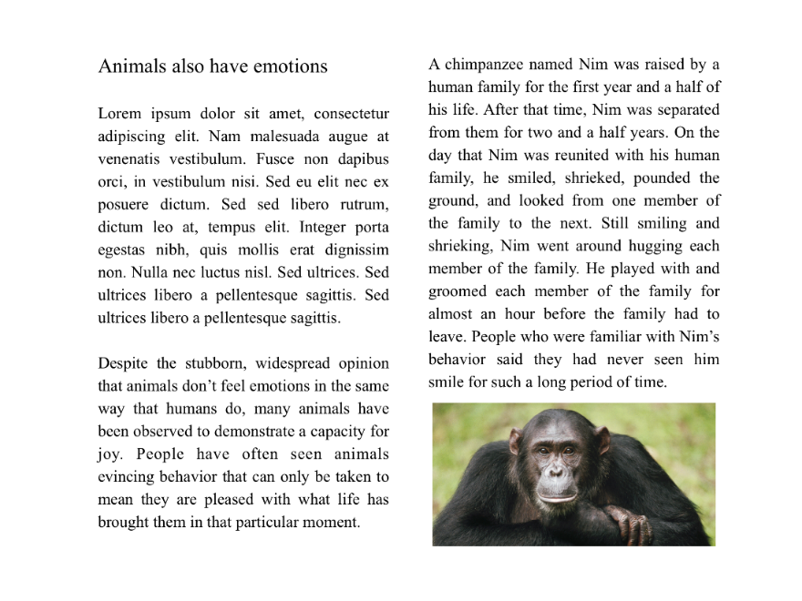
Study I Findings
Exploration Mode
Participants appreciated direct access to spatial information, and nearly all able to locate images and count the number of columns.
Notes:
Finally, a few participants mentioned that they liked the knowledge about the document’s layout that the exploration mode provided, and nearly all were able to use it to locate images and count the number of columns in a document.

Slide 59
Study Overview
Study I: initial iPad study (19 participants)
Study II: physical prototype study (4 participants)
Notes:
We conducted a follow-up study with 4 participants from Study I who returned to test our proof-of-concept wearable prototype

Slide 60
Study Overview
Study I: initial iPad study (19 participants)
Study II: physical prototype study (4 participants)
Notes:
The first study was primarily focused on the user experience, and the iPad let us performed detailed analysis of the participants finger movements. For this second study, we implemented the interfaces from our iPad version as a fully functioning physical prototype, which we called HandSight. We asked participants to try the system and provide subjective feedback, and also compared it against the KNFB Reader iPhone app, which was the current state of the art for reading printed documents.

Slide 61
Study Overview
Goals:
Evaluate HandSight prototype
Gather subjective feedback
Compare with KNFB Reader iOS
Study II: physical prototype study (4 participants)
Notes:
The first study was primarily focused on the user experience, and the iPad let us performed detailed analysis of the participants finger movements. For this second study, we implemented the interfaces from our iPad version as a fully functioning physical prototype, which we called HandSight. We asked participants to try the system and provide subjective feedback, and also compared it against the KNFB Reader iPhone app, which was the current state of the art for reading printed documents.

Slide 62
Study II: HandSight Prototype System
Finger-mounted camera to read physical documents
Notes:
Unfortunately I don’t have time to talk much about our prototype system, but all of the details are available in our paper. We used the same haptic and audio cues as in the first study and the process for exploring and reading a document was very similar from the participants’ perspective.

Slide 63
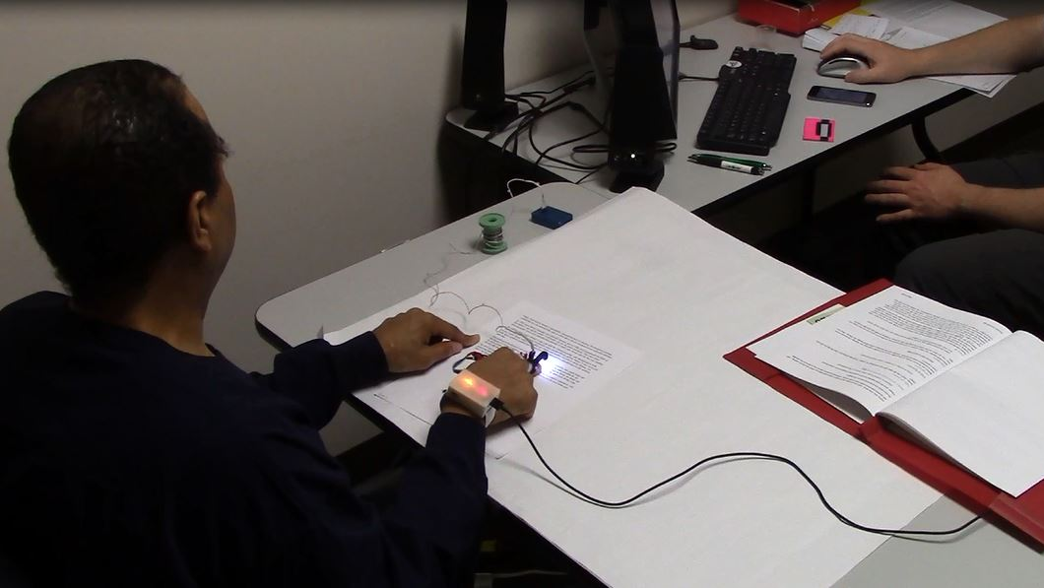
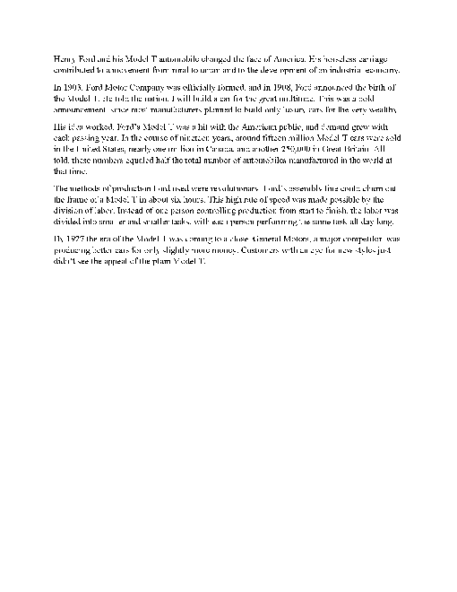
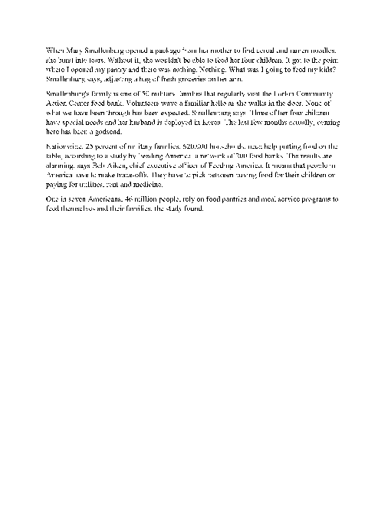
Study II Method
HandSight:
Each participant used their preferred guidance from Study I to explore and read two documents
Notes:
Participants each used their preferred directional guidance type from the first study to explore and read two documents using our prototype system. The documents had a single column and were approximately the same length and reading level.

Slide 64
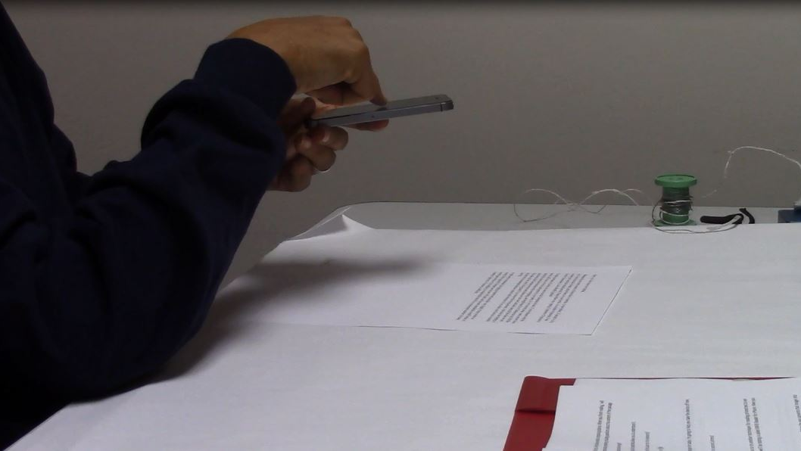
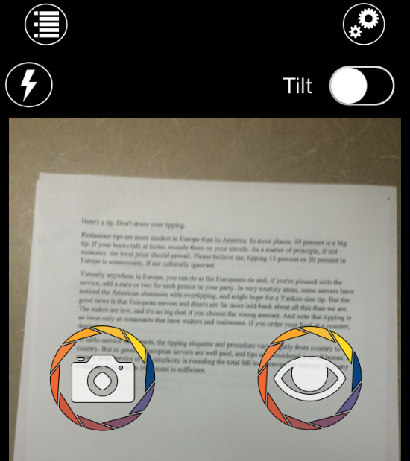
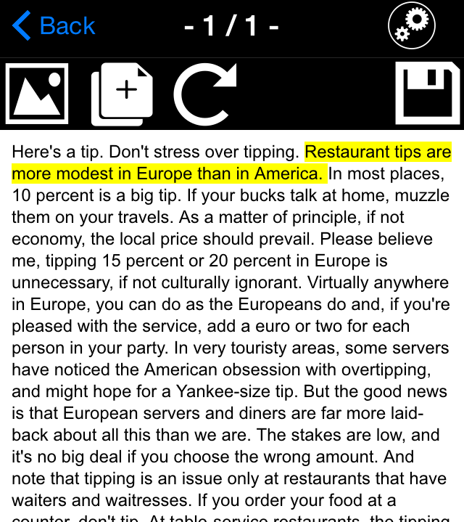
Study II Method
KNFB Reader iOS:
Photograph and read 3 physical documents
Notes:
Afterward, participants used the KNFB Reader iPhone app to photograph and read 3 more documents. Two of these were similar to those read with our prototype, but the third had two columns since KNFB Reader supports multi-column documents.

Slide 65
Study II Findings
HandSight: Overall Experience
Average reading speed: 45 wpm (SD=19, Range=18-60)
Rated somewhat easy to use, but slow and required concentration
Notes:
All four participants completed the reading tasks with our prototype, but their performance and subjective feedback was mixed.
The average reading speed was 45 words per minute, but the speed varied quite a bit. The participants all expressed concern over the level of concentration that was required to interpret the directional guidance and other audio cues while listening to the speech feedback.

Slide 66
Study II Findings
HandSight: Overall Experience
Average reading speed: 45 wpm (SD=19, Range=18-60)
Rated somewhat easy to use, but slow and required concentration
Participant Quotes:
“I’m very pleased and excited about the system. I think it could make a great difference in my life.” (P19)
“It seems like a lot of effort for reading text.” (P12)
Notes:
Two quotes in particular highlight the difference in opinions. One participant was enthusiastic about the concept, saying “I’m very pleased and excited about the system. I think it could make a great difference in my life.” Another was more critical, finding the approach to be slower than expected: “It seems like a lot of effort for reading text.”

Slide 67
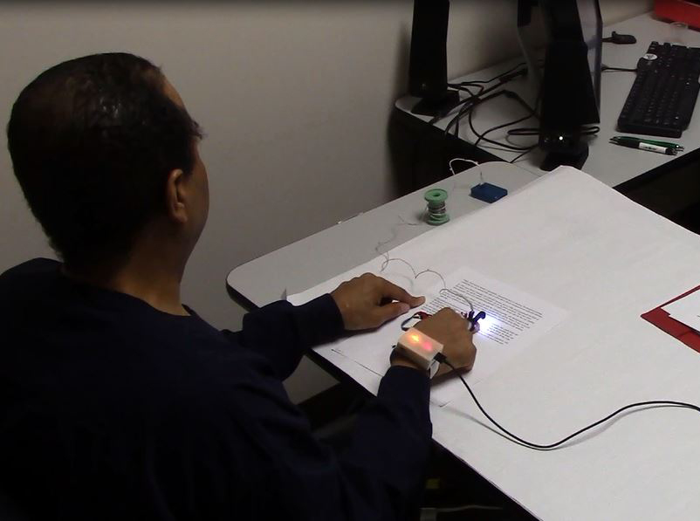
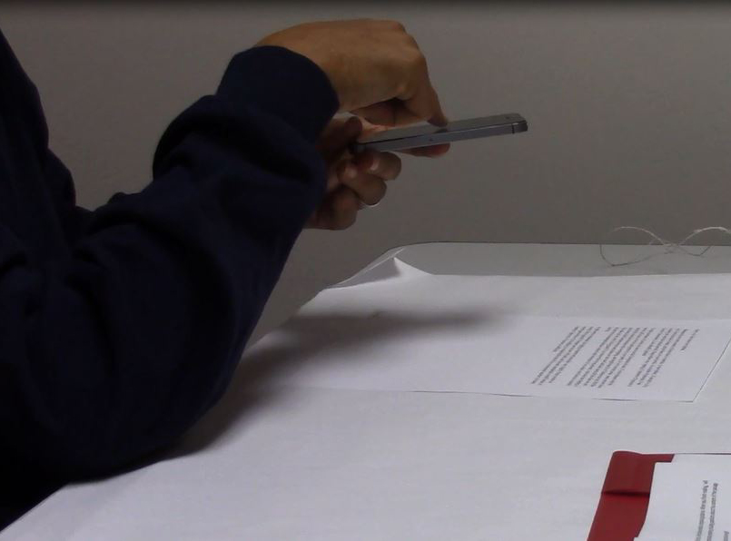
Study II Findings
HandSight vs. KNFB Reader iOS
Participants unanimously preferred KNFB Reader iOS
HandSight
KNFB Reader iOS
Notes:
I want to stress that our experiment with the KNFB Reader app was not a controlled comparison. But even without that and without using all of the app’s features, participants unanimously preferred KNFB Reader for the types of documents we asked them read.

Slide 68
Study II Findings
HandSight vs. KNFB Reader iOS
Participants unanimously preferred KNFB Reader iOS
Faster, easier to concentrate on the content of the text
HandSight
KNFB Reader iOS
Notes:
The main reason for that was how fluid the reading experience was after the document had been captured, since the app read the document quickly and participants were able to concentrate fully on the content.

Slide 69
Implications
Feasibility of a Finger-Based Reading Approach
Pros
Notes:
This ties into our original questions about the feasibility of a touch-based approach for reading printed text. We expected that it would have many advantages. [next slide] These included information about the spatial layout, [next slide] direct access to the text on the page and control over the reading speed, [next slide] easier camera framing, [next slide] and the potential for more efficient text detection and recognition.

Slide 70
Implications
Feasibility of a Finger-Based Reading Approach
Pros
Spatial layout information
Notes:
This ties into our original questions about the feasibility of a touch-based approach for reading printed text. We expected that it would have many advantages. [next slide] These included information about the spatial layout, [next slide] direct access to the text on the page and control over the reading speed, [next slide] easier camera framing, [next slide] and the potential for more efficient text detection and recognition.

Slide 71
Implications
Feasibility of a Finger-Based Reading Approach
Pros
Spatial layout information Direct control over reading
Notes:
This ties into our original questions about the feasibility of a touch-based approach for reading printed text. We expected that it would have many advantages. [next slide] These included information about the spatial layout, [next slide] direct access to the text on the page and control over the reading speed, [next slide] easier camera framing, [next slide] and the potential for more efficient text detection and recognition.

Slide 72
Implications
Feasibility of a Finger-Based Reading Approach
Pros
Spatial layout information Direct control over reading Reduced camera framing issues
Notes:
This ties into our original questions about the feasibility of a touch-based approach for reading printed text. We expected that it would have many advantages. [next slide] These included information about the spatial layout, [next slide] direct access to the text on the page and control over the reading speed, [next slide] easier camera framing, [next slide] and the potential for more efficient text detection and recognition.

Slide 73
Implications
Feasibility of a Finger-Based Reading Approach
Pros
Spatial layout information Direct control over reading Reduced camera framing issues Efficient text detection and recognition
Notes:
This ties into our original questions about the feasibility of a touch-based approach for reading printed text. We expected that it would have many advantages. [next slide] These included information about the spatial layout, [next slide] direct access to the text on the page and control over the reading speed, [next slide] easier camera framing, [next slide] and the potential for more efficient text detection and recognition.

Slide 74
Implications
Feasibility of a Finger-Based Reading Approach
Pros
Spatial layout information Direct control over reading Reduced camera framing issues Efficient text detection and recognition * We observed these in our studies
Notes:
We did observe these advantages in our experiments, but some important concerns also came up.

Slide 75
Implications
Feasibility of a Finger-Based Reading Approach
Pros | Cons
Spatial layout information Direct control over reading Reduced camera framing issues Efficient text detection and recognition * We observed these in our studies | Slower, requires increased concentration and physical dexterity
Notes:
Our studies showed that reading text line-by-line can be slow and require high mental and physical effort. The reader has to pay attention to multiple haptic or audio cues along with the speech feedback.

Slide 76
Implications
Feasibility of a Finger-Based Reading Approach
Pros | Cons
Spatial layout information Direct control over reading Reduced camera framing issues Efficient text detection and recognition * We observed these in our studies | Slower, requires increased concentration and physical dexterity * Consistent with Shilkrot et al. 2014, 2015
Notes:
This finding is consistent with previous work in this area, and is one of the biggest limitations of our approach. Practice and improvements to the guidance interface might help, but we’d need to do a longer study over multiple sessions to see how much.

Slide 77
Implications
Feasibility of a Finger-Based Reading Approach
Pros | Cons
Spatial layout information Direct control over reading Reduced camera framing issues Efficient text detection and recognition * We observed these in our studies | Slower, requires increased concentration and physical dexterity * Consistent with Shilkrot et al. 2014, 2015 Importance of spatial layout information is unclear
Notes:
We also don’t know how important spatial layout information will be in general. For relatively simple documents like the ones we used in our studies, it might not have much benefit. But for documents with important spatial information, such as maps and graphs, an approach like ours could become much more useful.

Slide 78
Implications
Feasibility of a Finger-Based Reading Approach
Pros | Cons
Spatial layout information Direct control over reading Reduced camera framing issues Efficient text detection and recognition * We observed these in our studies | Slower, requires increased concentration and physical dexterity * Consistent with Shilkrot et al. 2014, 2015 Importance of spatial layout information is unclear * Has yet to be investigated in this context
Notes:
To our knowledge, no one has investigated this question as of yet, at least not in the context of touch-based access to physical documents.

Slide 79
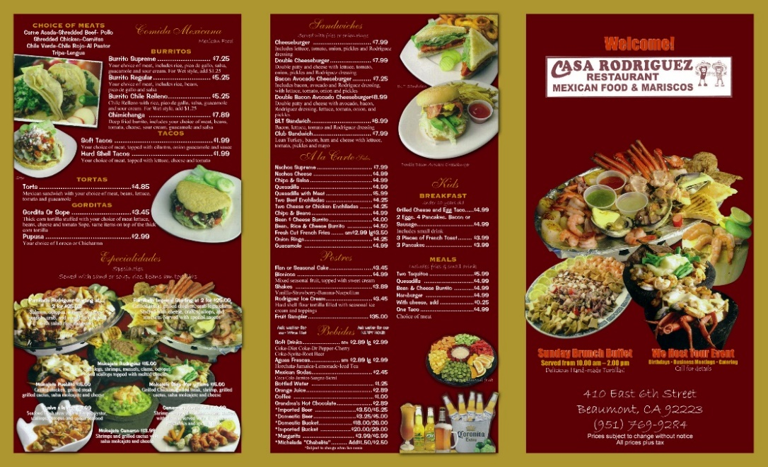
Future Work
Study utility of spatial layout information in everyday use
(e.g., newspapers, menus, maps, graphs)
Notes:
Toward that end, we plan to run a more in-depth study in the near future with these types of documents to see how useful spatial layout information might be in everyday use.

Slide 80
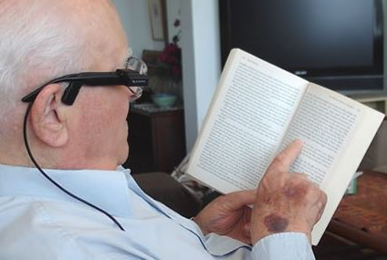
Future Work
Study utility of spatial layout information
Explore possibilities for camera placement
Notes:
We’ve also considered the idea that a hybrid system might be a good compromise. It could use a body-mounted camera to determine context and read back longer passages, but then use the finger-mounted camera for immediate access and exploration.

Slide 81
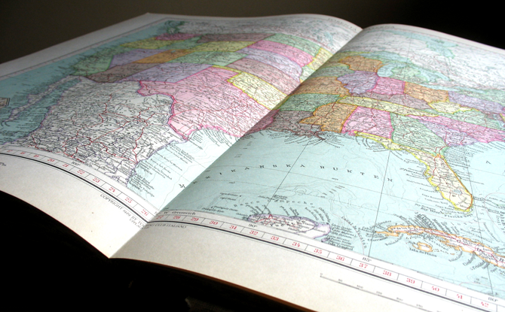
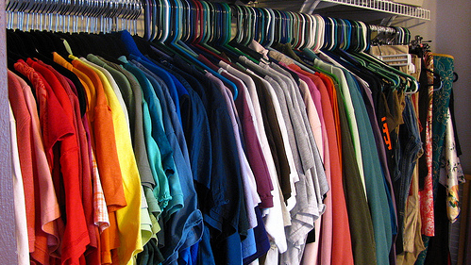
HandSight
a vision augmented touch system
Notes:
Finally, reading is only one of the applications we hope to support, and our goal is to produce a wearable device that augments the sense of touch and helps with a variety of activities of daily living.

Slide 82
Questions?
Evaluating Haptic and Auditory Guidance to Assist Blind People in Reading Printed Text Using Finger-Mounted Cameras
TACCESS | ASSETS 2016
Contact: lstearns@umd.edu
Lee Stearns¹, Ruofei Du¹, Uran Oh¹, Catherine Jou¹, Leah Findlater², David A. Ross³, Jon E. Froehlich¹
University of Maryland: Computer Science¹, Information Studies², Atlanta VA R&D Center for Visual & Neurocognitive Rehabilitation³
Thank you to our participants and the Maryland State Library for the Blind and Physically Handicapped.
This research was funded by the Department of Defense.
Notes:
That’s it for my presentation. Thank you to everyone on my team, and to all of you attending today.

Slide 83
Limitations of previous studies*
Small sample size (3-4 participants)
No quantitative performance metrics
Contradictory participant preferences
* Stearns et al. 2014, Shilkrot et al. 2014, 2015
Notes:
Previous research has used directional guidance methods similar to these, but in each case the focus was on feasibility. The user studies had small sample sizes of 3 to 4 participants, and didn’t report on quantitative performance metrics. That prevents us from fully understanding the effectiveness of finger guidance, as well as the reading performance and user reactions. Participants in the previous studies also had contradictory preferences when comparing the different types of directional guidance.

