Slide 1
Eye-dominance-guided Foveated Rendering
Xiaoxu Meng, Ruofei Du, and Amitabh Varshney
IEEE Transactions on Visualization and Computer Graphics (TVCG)
Notes:
Good Morning. Today I’m going to present Eye-dominance-guided foveated rendering.
Before we start with this paper, let’s play a game together.

Slide 2
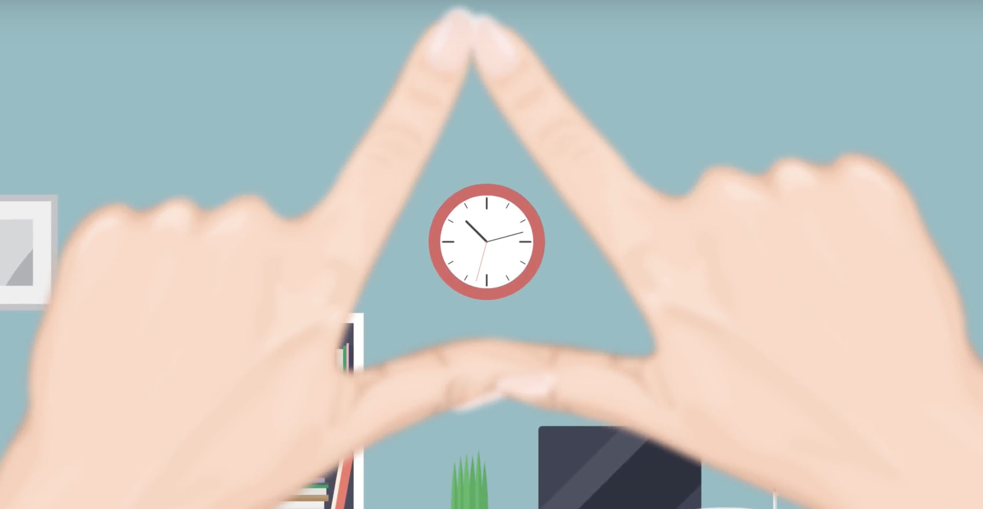
Notes:
Firstly, please extend your arms out in front of you, and create a triangle with your thumbs and index figures.
Next, frame a distant object within this triangle and keep your both eyes open.

Slide 3
Notes:
Step 3, close your right eye with your left eye open,

Slide 4
Notes:
Step 4, close your left eye with your right eye open,

Slide 5
Notes:
You may find that the framed object disappears in Step 3 or Step 4. But remain centered in the other step.
It seems that the two eyes are not working together to see the world.

Slide 6
Ocular Dominance: the tendency to prefer scene perception from one eye over the other.
Notes:
your visual system is showing tendency to prefer scene perception from one eye over the other.
It is somewhat analogous to the right- or left-handedness;
This phenomenon is called eye dominance or ocular dominance. The preferred eye is called the dominant eye.

Slide 7
Advantage of the Dominant Eye Over the Non-dominant Eye
better color-vision discrimination ability [Koctekin 2013]
shorter reaction time on visually triggered manual action [Chaumillon 2014]
better visual acuity, contrast sensitivity [Shneor 2006]
Notes:
There has been lots of research exploring the difference between the dominant eye and the non-dominant eye.
It has been shown that dominant eye has priority in red/green color discrimination, has shorter reaction time and better visual acuity and contrast sensitivity.

Slide 8
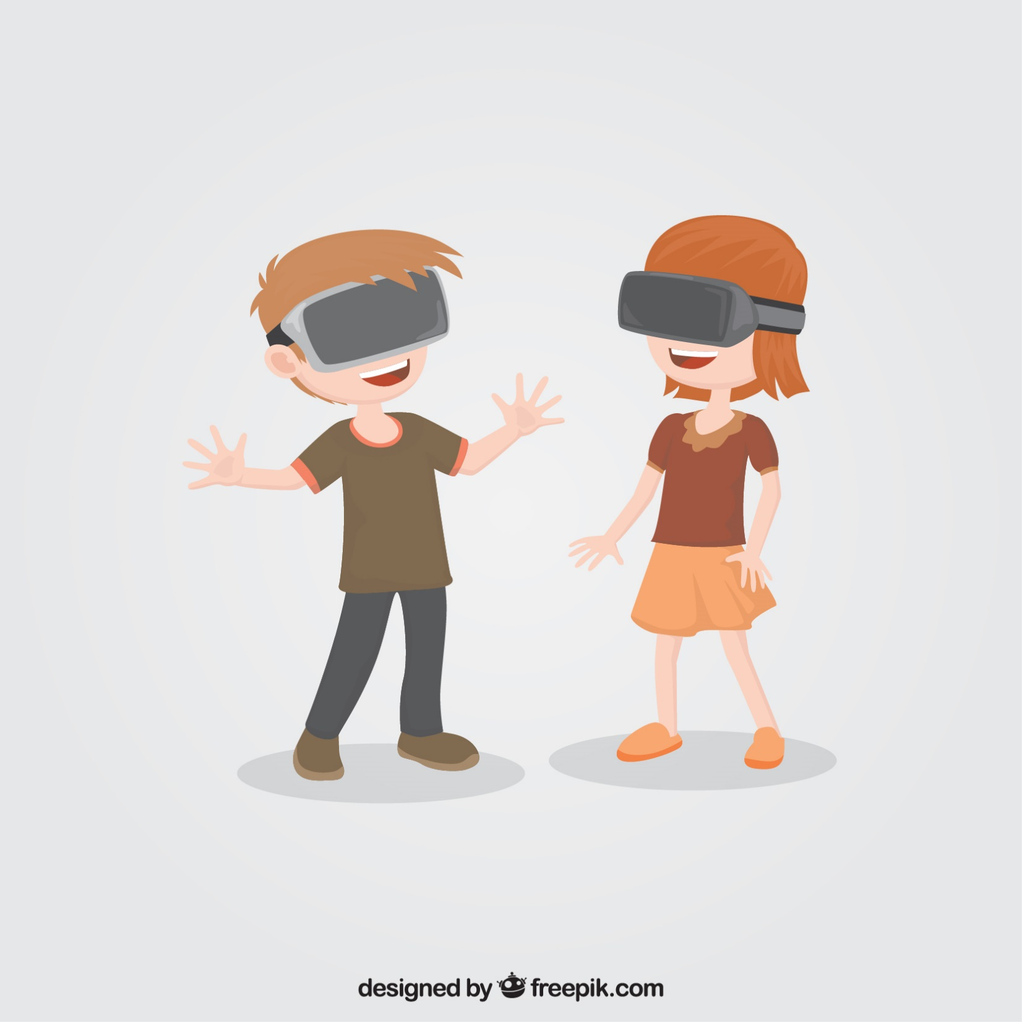
Application | Resolution | Frame rate | MPixels / sec
Desktop game | 1920 x 1080 x 1 | 60 | 124
2018 VR (HTC Vive PRO) | 1440 x 1600 x 2 | 90 | 414
2020 VR (Varjo) | 1920 x 1080 x 2 + 1440 x 1600 x 2 | 90 | 788
Notes:
Now let’s get back to VR.
The rendering burden for VR is enormous. That’s why people come up with the idea of foveated rendering.

Slide 9
Foveated Rendering
VR requires enormous rendering budget
Most pixels are outside the fovea
Notes:
Here I need to introduce the concept of fovea.
Fovea is the center of the retina, which corresponds to the center of the vision field.
The number of visual cells decrease continuously from fovea to the periphery.
As a result, the resolution of human eyes is the highest resolution in the fovea, and gradually decreasing with the increase of the eccentricity.

Slide 10
Foveated Rendering
VR requires enormous rendering budget
Most pixels are outside the fovea
Percentage of the foveal pixels
96 %
27 %
4 %
* Data from Siggraph 2017, by Anjul Patney, August 2017
Notes:
According to the research in 2017, only 4% percent of the VR pixels are fovea pixels that people can see directly, for the remaining ninety six percent, we are not directly looking at the pixels.

Slide 11
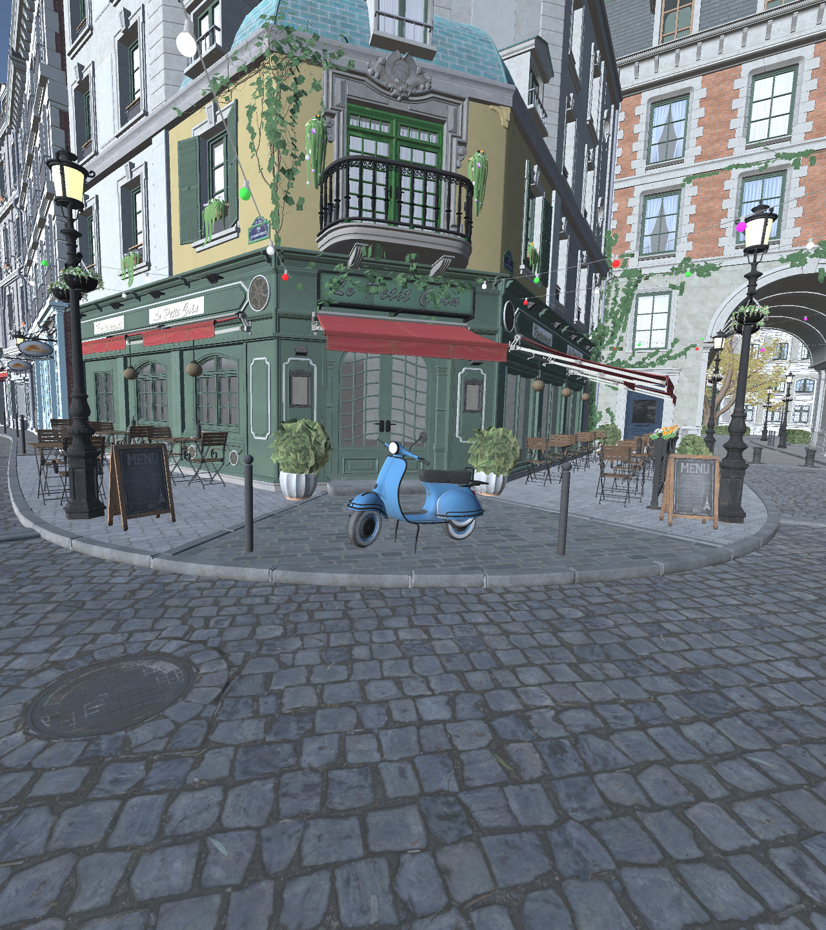
Notes:
If we tell the renderer where the user is looking at

Slide 12
fovea
fovea
Notes:
and we just let the GPU render peripheral region with lower quality and the user of the VR headset cannot notice that. This is called foveated rendering.
As we know, there is always a tradeoff between the rendering quality and the frame rate. If we render the peripheral region with lower quality, we can save the cost of rendering and get higher frame rate.

Slide 13
Can we do better?
Notes:
Can we do better than foveated rendering?

Slide 14
fovea
fovea
non-dominant eye
Notes:
Because we know the non-dominant eye has weaker visual acuity and contrast sensitivity.

Slide 15
fovea
fovea
more foveation for the non-dominant eye
Notes:
Why not render the non-dominant eye with more foveation?

Slide 16
Eye-dominance-guided Foveated Rendering
Overview
Notes:
Therefore, we started to investigate:
An eye-dominance-guided foveation system

Slide 17
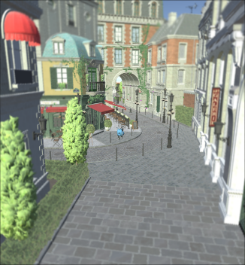
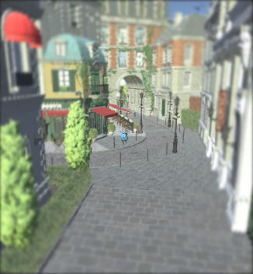
For the dominant eye:
Renderer with less foveation
For the non-dominant eye:
Renderer with more foveation
Notes:
Our idea is using two foveated renderers. For the dominant eye, we render with less foveation. And for the non-dominant eye, we render with more foveation.

Slide 18
A foveation model with adjustable foveation level?
Notes:
So we need a foveation model which allow us to parameterize and change the level of foveation.

Slide 19
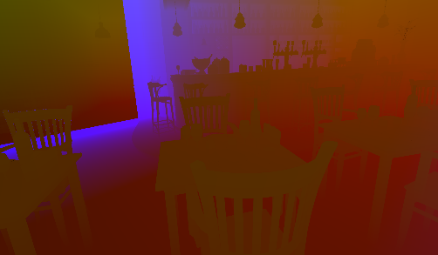
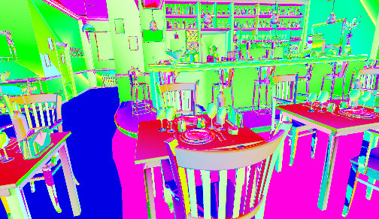
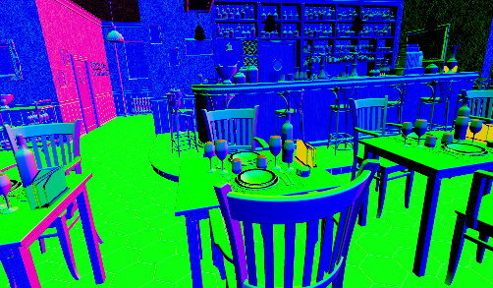
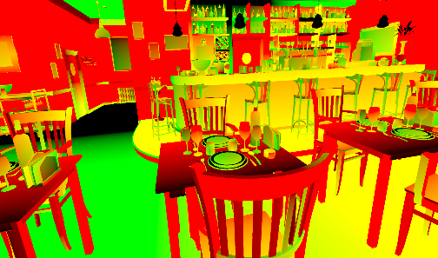
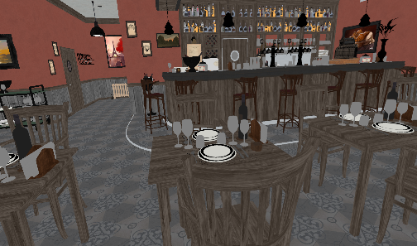
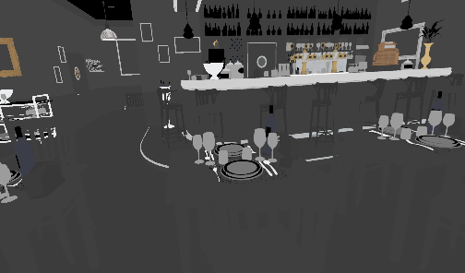
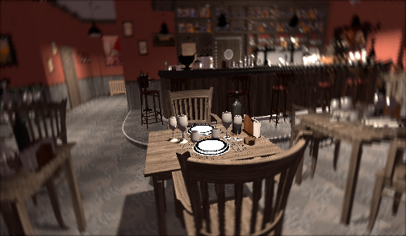
Kernel Foveation Model
A model with parameterized level of foveation
G-buffer
Kernel log-polar transformation
LP-buffer ($σ = 3.0$)
Shading &
internal anti-aliasing
World position
Bit tangent
Normal
Inverse kernel
log-polar transformation
& post anti-aliasing
Screen
Texture coordinates
Albedo map
Roughness, ambient, and refraction maps
Notes:
We use the kernel foveation model, which parameterize the level of foveation with one parameter.

Slide 20
Kernel Foveation Model
A model with parameterized level of foveation
G-buffer
Kernel log-polar transformation
LP-buffer ($σ = 3.0$)
Shading &
internal anti-aliasing
World position
Bit tangent
Normal
Inverse kernel
log-polar transformation
& post anti-aliasing
Screen
Texture coordinates
Albedo map
Roughness, ambient, and refraction maps
Notes:
In the first pass, we compute the kernel log polar transformation of the G-buffer and render to a reduced resolution buffer.

Slide 21
Kernel Foveation Model
A model with parameterized level of foveation
G-buffer
Kernel log-polar transformation
LP-buffer ($σ = 3.0$)
Shading &
internal anti-aliasing
World position
Bit tangent
Normal
Inverse kernel
log-polar transformation
& post anti-aliasing
Screen
Texture coordinates
Albedo map
Roughness, ambient, and refraction maps
Notes:
In the second pass, we carry out the inverse log-polar transformation and perform anti-aliasing to map the reduced resolution rendering to the full resolution screen.

Slide 22
Kernel Foveation Model
A model with parameterized level of foveation
G-buffer
Kernel log-polar transformation
LP-buffer ($σ = 3.0$)
Shading &
internal anti-aliasing
World position
Bit tangent
Normal
Inverse kernel
log-polar transformation
& post anti-aliasing
Screen
Texture coordinates
Albedo map
Roughness, ambient, and refraction maps
Notes:
We know that the rendering cost is proportional to the rendering resolution.
Because the rendering happens in the reduced resolution buffer instead of the screen, the shading cost can be greatly reduced.

Slide 23
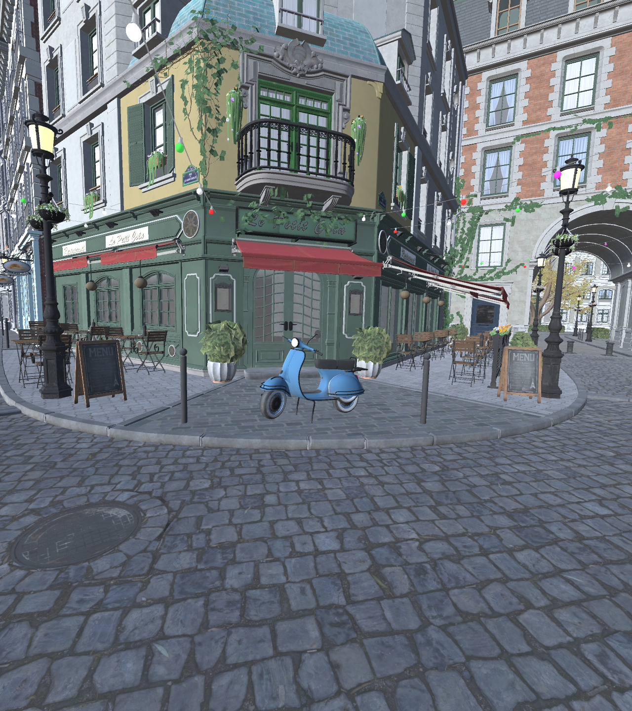
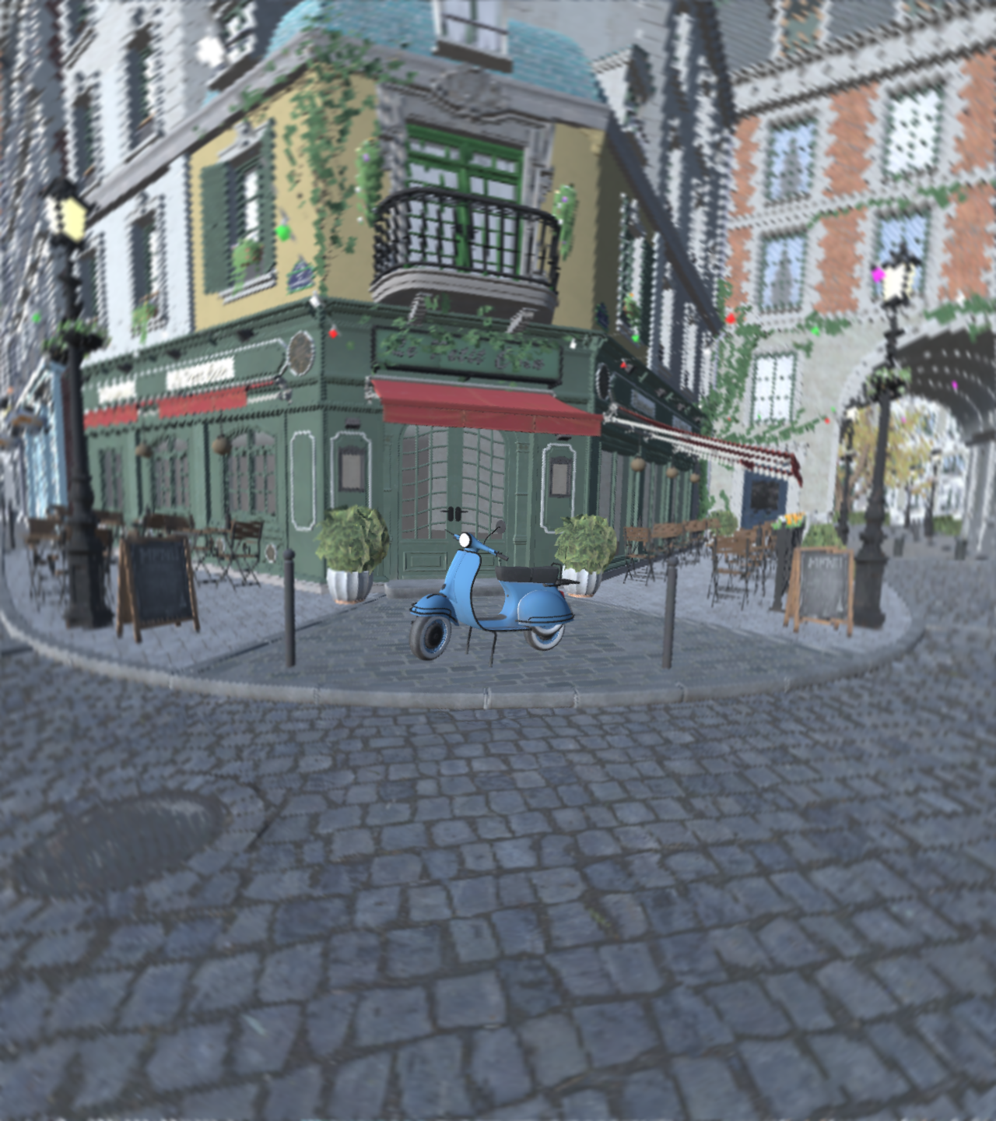
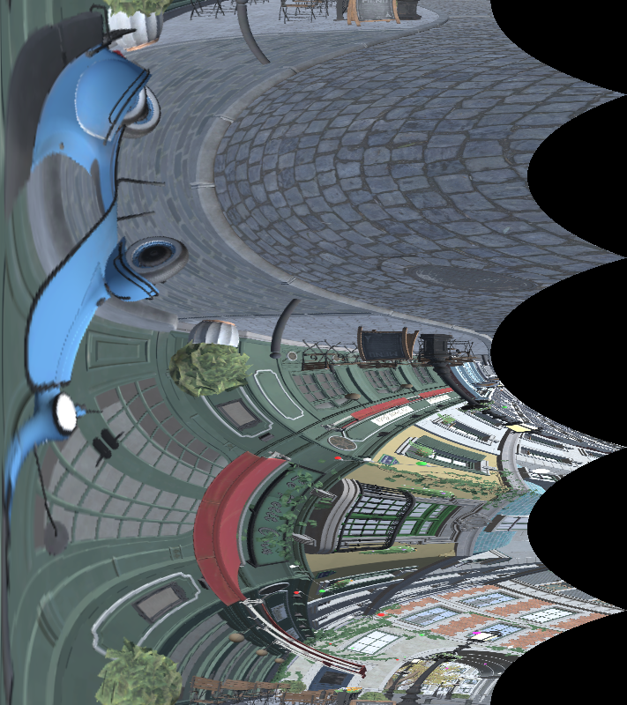
Kernel Foveation Model
Original Frame
Foveation Buffer
Foveated Frame
$$w$$
$$W$$
$$W$$
Kernel log-polar Mapping
Buffer parameter σ $=\frac{W}{w}$
Regular rendering time: $t_{RR}=T$
Kernel foveated rendering time: $t_{KFR}=\frac{T}{σ^{2}}$
Notes:
We define the the ratio between the width of the screen and the width of the buffer as sigma.
And the time to render a regular frame as T
The time to render a foveated frame is T over sigma square.

Slide 24
Kernel Foveation Model
A model with parameterized level of foveation
Regular Rendering
LP-buffer
$$σ=1.2$$
Foveated Rendering
(without anti-aliasing)
Notes:
With the increase of parameter sigma, the buffer size becomes smaller, the rendering quality goes lower, and the rendering becomes faster.

Slide 25
Kernel Foveation Model
A model with parameterized level of foveation
Regular Rendering
LP-buffer
$$σ=1.4$$
Foveated Rendering
(without anti-aliasing)

Slide 26
Kernel Foveation Model
A model with parameterized level of foveation
Regular Rendering
LP-buffer
$$σ=1.6$$
Foveated Rendering
(without anti-aliasing)

Slide 27
Kernel Foveation Model
A model with parameterized level of foveation
Regular Rendering
LP-buffer
$$σ=1.8$$
Foveated Rendering
(without anti-aliasing)

Slide 28
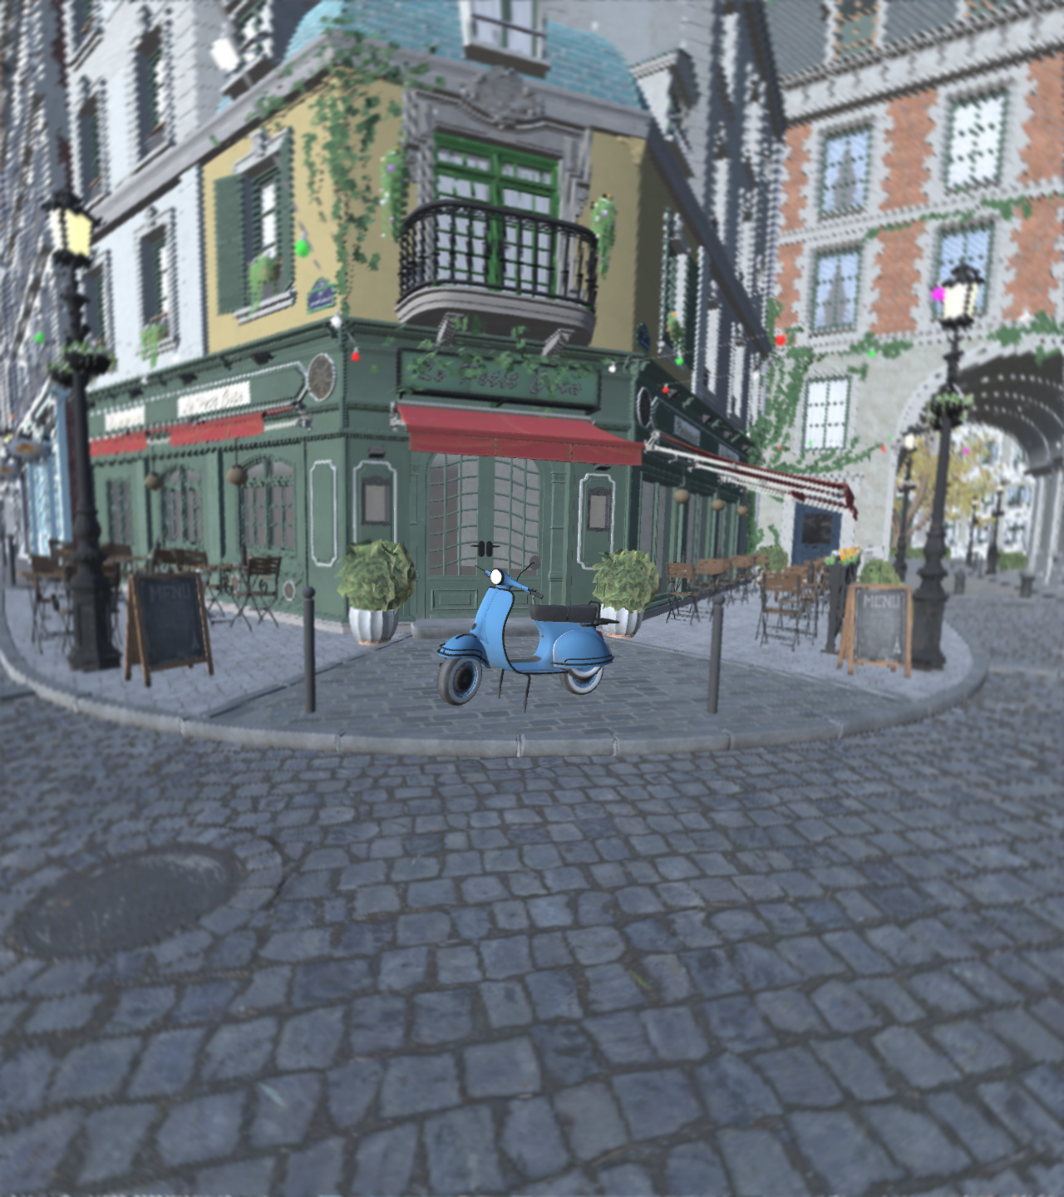
Kernel Foveation Model
A model with parameterized level of foveation
Regular Rendering
LP-buffer
$$σ=2.0$$
Foveated Rendering
(without anti-aliasing)

Slide 29
Kernel Foveation Model
A model with parameterized level of foveation
Regular Rendering
LP-buffer
$$σ=2.2$$
Foveated Rendering
(without anti-aliasing)

Slide 30
Kernel Foveation Model
A model with parameterized level of foveation
Regular Rendering
LP-buffer
$$σ=2.4$$
Foveated Rendering
(without anti-aliasing)

Slide 31
Kernel Foveation Model
A model with parameterized level of foveation
Regular Rendering
LP-buffer
$$σ=2.6$$
Foveated Rendering
Foveated Rendering
(without anti-aliasing)

Slide 32
Dominant eye foveation parameter: $σ_{d}$
KFR
Transformer
Shading
Inv-KFR
Transformer
Anti-aliasing
Non-dominant eye foveation parameter: $σ_{nd}>σ_{d}$
KFR
Transformer
Shading
Inv-KFR
Transformer
Anti-aliasing
Notes:
Here’s the overview of the eye-dominance-guided foveated rendering system. Our system uses two foveated renderers, with different values of the foveation parameter σ, for the dominant eye and the non-dominant eye, respectively. For the dominant eye, we choose the foveation parameter σd which results in an acceptable foveation level for both eyes. For the non-dominant eye, we choose σnd ≥ σd , which corresponds to a higher foveation level. Because the non-dominant eye is weaker in sensitivity and acuity, the user is unable to notice the difference between the two foveation frames.

Slide 33
User Study
Apparatus
Notes:
Now we have a foveated rendering system with adjustable foveation parameters.
Our next step is to find the parameters sigma_d and sigma_nd by conducting a user study.

Slide 34
Pre-experiment: Dominant Eye Identification
The Miles Test
the participant (TP) extends their arms out in front of himself
creates a triangular opening between their thumbs and forefingers
with both eyes open, TP centers the triangular opening on a goal object that is 20 feet away from TP
TP closes their left eye with their right eye open, and the object moves out of center
Left eye dominant
TP closes their right eye with their left eye open, and the object moves out of center
Right eye dominant
Notes:
Before we start the user study, we need to find the dominant eye for the participants.
We conduct the Miles test, which is exactly the game we have played together.

Slide 35
Main Study
Step 1: The participant estimates the
Uniform Foveation Parameter $σ_{UF}$
Step 2: The participant estimates the
Non-dominant Eye Foveation Parameter $σ_{NF}$
Step 3: The participant evaluates the
quality of EFR with $σ_{UF}$ and $σ_{NF}$
by comparing with RR and KFR
EFR: eye-dominance-guided foveated rendering
KFR: traditional foveated rendering
RR: regular rendering
Notes:
And next, we can conduct the main study with three steps,
In the first step, the participant estimates the Uniform Foveation Parameter σ_UF, which is acceptable for both the dominant eye and the non- dominant eye

Slide 36
Main Study
Step 1: The participant estimates the
Uniform Foveation Parameter $σ_{UF}$
Step 2: The participant estimates the
Non-dominant Eye Foveation Parameter $σ_{NF}$
Step 3: The participant evaluates the
quality of EFR with $σ_{UF}$ and $σ_{NF}$
by comparing with RR and KFR
EFR: eye-dominance-guided foveated rendering
KFR: traditional foveated rendering
RR: regular rendering
Notes:
In the second step, the participant estimates the Non-dominant Eye Foveation Parameter σ_NF which results in the same overall visual perception as the uniform foveation,

Slide 37
Main Study
Step 1: The participant estimates the
Uniform Foveation Parameter $σ_{UF}$
Step 2: The participant estimates the
Non-dominant Eye Foveation Parameter $σ_{NF}$
Step 3: The participant evaluates the
quality of EFR with $σ_{UF}$ and $σ_{NF}$
by comparing with RR and KFR
EFR: eye-dominance-guided foveated rendering
KFR: traditional foveated rendering
RR: regular rendering
Notes:
The third step is the quality evaluation. The participant evaluates the quality of the EFR with the estimated parameters σ_UF and σ_NF by comparing the EFR with regular rendering and traditional foveated rendering

Slide 38
Main Study
Step 1: The participant estimates the
Uniform Foveation Parameter $σ_{UF}$
Step 2: The participant estimates the
Non-dominant Eye Foveation Parameter $σ_{NF}$
Step 3: The participant evaluates the
quality of EFR with $σ_{UF}$ and $σ_{NF}$
by comparing with RR and KFR
scenes for the user study
3 scenes for Step 1 & Step 2, 10 scenes for Step 3
Notes:
We selected 10 computer-generated environments as the scenes for the user study.
We choose 3 scenes for Step1 and Step2
And we use all the 10 scenes for Step 3, the quality evaluation.

Slide 39
Main Study
Two tests in the main study:
Slider Test
Random Test
Each test is repeated 3 times for each participant to reduce inaccuracy in parameter estimation.
Notes:
In our main study. We conduct a Slider Test and a Random Test.
The two tests measure the foveation parameter with different experiment setups.
Of course, we expect that the parameters estimated from different tests can coincide.
Each test is repeated 3 times for each participant to reduce inaccuracy in parameter estimation

Slide 40
Main Study
Two tests in the main study:
Slider Test
Random Test
Each test is repeated 3 times for each participant to reduce inaccuracy in parameter estimation.
σ $=\frac{W}{w}$ ($W$: width of the screen, $w$: width of the rendering buffer)
Step 1 (Estimation of Uniform Foveation Parameter $σ_{UF}$):
MIN = 1.2
MAX = 3.0
STEP_SIZE = 0.2
Step 2 (Estimation of Non-dominant Eye Foveation Parameter $σ_{NF}$):
MIN = $σ_{UF}$
MAX = 4.0
STEP_SIZE = 0.2
Notes:
In step 1, the estimation of σ_UF, the parameter sigma ranges between 1.2 to 3.0
In step 2, the estimation of σ_NF, we want to find a parameter which is greater than σ_UF. So the parameter ranges between σ_UF to 4.0.
We choose a higher upper bound for the non-dominant eye

Slide 41
User Study
Main Study - Slider Test
Notes:
Okay, let’s take a look at the procedure of the Slider Test.

Slide 42
Slider Test
Step 1: Estimation of $σ_{UF}$
Step 1.1: Present the participant with the regular rendering as a reference
Step 1.2: Present the participant with the same foveated rendering for both eyes and allow the participant to adjust the level of foveation by themselves
starting with the highest level of foveation
progressively decrease the foveation level
The participant switches between Step1.1 and Step 1.2 back and forth until he/she can identify the lowest foveation $σ_{UF}$
Step 1.1 regular rendering as reference
1.2
3.0
$$σ_{UF}$$
Step 1.2 foveated rendering
(same foveation for both eyes)
Notes:
In step 1
We allow the participant to adjust the level of foveation by themselves. He or she can also switch between the full-resolution reference and the foveated frame back and forth until he can identify the lowest foveation σ_UF.

Slide 43
Slider Test
Step 2: Estimation of $σ_{NF}$
Step 2: Present the participant foveated rendering with $σ_{UF}$ for the dominant eye, allow the participant to adjust the foveation level for the non-dominant eye
starting with foveation parameter $σ_{UF}$
progressively increase the foveation level
The participant finds the highest foveation level $σ_{NF}$ that is perceptually equivalent to the result in Step 1
$$σ_{UF}$$
4.0
$σ_{NF} σ_{NF}$
Step 2 foveated rendering
Notes:
In step 2,
We present the participant the foveated rendering with σ_UF for the dominant eye,
and allow the participant to adjust the foveation level for the non-dominant eye until he or she finds the highest foveation level σ_NF that is perceptually equivalent to the result in Step 1.

Slide 44
Slider Test
Step 3: Quality Evaluation
The participant compares between
EFR vs. KFR
EFR vs. RR
the participant scores the difference between the two frames
Max score = 5 (Same)
Min score = 1 (Noticeable Difference)
regular rendering
$σ_{NF} σ_{UF}$
Eye-dominance-guided foveated rendering
Choose a score for the difference between the two renderings?
1
2
3
4
5
Notes:
Now we have both σ_UF and σ_NF, we can conduct a quality evaluation by comparing EFR and other renderings.
And the participant scores the difference between the two rendering from 5 to 1.
If the score is high, EFR and the other renderings will be perceptually similar.

Slide 45
User Study
Main Study - Random Test
Notes:
Now let’s talk about the other test: random test.

Slide 46
Random Test
Step 1: Estimation of $σ_{UF}$
shuffled parameter array [1.2, 3.0]
The participant observes the regular rendering & traditional foveated rendering with $x$ selected from shuffled parameter array
The participant scores the difference between the two frames $S_{UF}(x)$
Max score = 5 (Same)
Min score = 1 (Noticeable Difference)
$σ_{UF}=\underset{x}{argmax}{S_{UF}(x) }≥4$
regular rendering
$σ_{UF} σ_{UF}$
kernel foveated rendering
Choose a score for the difference between the two renderings?
1
2
3
4
5
Notes:
The random test is similar to the slider test. The only difference is that the user cannot adjust the level of foveation by themselves.
Instead, we show them foveated rendering with parameter $x$ selected from shuffled parameter array.
And the participant scores the difference between the two frames and gives a score of the difference.
Score Five stands for no difference and Score one stands for obvious difference.
We choose the maximum x which results in score 4 or 5 as σ_UF..

Slide 47
Random Test
Step 2: Estimation of $σ_{NF}$
shuffled parameter array [$σ_{UF}$, 4.0]
The participant observes eye-dominance-guided foveated rendering
Dominant eye rendered with $σ_{UF}$
Non-dominant eye rendered with $x$ selected from shuffled parameter array
the participant scores the imbalance between the two frames $S_{UF}(x)$
Max score = 5 (Same)
Min score = 1 (Noticeable Imbalance)
$σ_{NF}=\underset{x}{argmax}{S_{NF}(x) }≥4$
$σ_{NF} σ_{UF}$
Eye-dominance-guided foveated rendering
Choose a score for the difference between the two renderings?
1
2
3
4
5
Notes:
in step 2, we estimate of σ_NF
we render the frame with σ_UF for the dominant eye,
we render the frame with a randomly selected parameter for the dominant eye,
And the user scores the imbalance between the dominant eye and the non-dominant eye

Slide 48
Random Test
Step 3: Quality Evaluation
The participant compares between
EFR vs. KFR
EFR vs. RR
the participant scores the difference between the two frames
Max score = 5 (Same)
Min score = 1 (Noticeable Difference)
regular rendering
$σ_{NF} σ_{UF}$
Eye-dominance-guided foveated rendering
Choose a score for the difference between the two renderings?
1
2
3
4
5
Notes:
And the quality evaluation is the same as the quality evaluation step in the slider test.

Slide 49
User Study Result
Notes:
We did the user study for 11 users, and now we present the results.

Slide 50
Notes:
We compare σ_UF and σ_NF estimated from the two tests of the 11 users.
We can observe an obvious gap between σ_UF and σ_NF.

Slide 51
Analysis: Relationship between $σ_{UF}$ and $σ_{NF}$
Is there a significant difference of $σ_{UF}$ and $σ_{NF}$ between the slider test and the random test?
Null hypothesis
there is no significant difference of $σ_{UF}$ and $σ_{NF}$ between the slider test and the random test
Paired T-test
No significant difference between the slider test and the random test (with $p=0.8995>0.05$)
Notes:
A paired T-test shows that there is no significant difference between the result of the slider test and the random test.

Slide 52
Analysis: Relationship between $σ_{UF}$ and $σ_{NF}$
Is there a significant difference between $σ_{UF}$ and $σ_{NF}$?
Null hypothesis
there is no significant difference between $σ_{UF}$ and $σ_{NF}$
Paired T-test
Significant difference that the foveation parameter $σ_{NF}$ required for the non-dominant eye is higher than the foveation parameter $σ_{UF}$for the dominant eye (with $p=7.0530×{10}^{−10}<0.05$)
Notes:
And we can observe that the σ_NF is significantly higjnher than the σ_UF.
So EFR can surely render with higher speed.
But what about the perceptual quality of eye-dominance-guided foveated rendering?

Slide 53
Quality Evaluation
Score frequency in the slider test and the random test
Comparison | Score = 1 | Score = 2 | Score = 3 | Score = 4 | Score = 5
Slider: EFR vs. RR | 0.00% | 2.73% | 8.18% | 17.27% | 71.82%
Slider EFR vs. KFR | 0.00% | 4.55% | 10.91% | 30.00% | 54.55%
Random: EFR vs. RR | 0.00% | 0.00% | 0.91% | 14.55% | 84.55%
Random: EFR vs. KFR | 0.00% | 0.91% | 3.64% | 25.45% | 70.00%
Slider Test: P(score ≥ 4) ≥ 85%
Random Test: P(score ≥ 4) ≥ 95%
Notes:
We calculated the percentage of each score in the quality evaluation.
We can notice that in the slider test, more than 85% of the users give a score of 4 or 5. And in the random test, more than 95% of the users gave a score of 4 or 5.

Slide 54
Rendering Acceleration
Notes:
And what about the acceleration?

Slide 55
Rendering Acceleration
Setup
GPU: NVIDIA GTX 1080
Scene: Amazon Lumberyard Bistro
Resolution: 1280 × 1440 per eye
Notes:
We measure the rendering acceleration with a GTX 1080 GPU for the FOVE headsets with a resolution of 1280x1440 per eye.

Slide 56
RR = Regular Rendering
KFR = Kernel Foveated Rendering
EFR = Eye-dominance-guided Foveated Rendering
Notes:
And here is the result for the 11 users.
We show the frame rate for regular rendering, kernel foveated rendering and eye-dominance-guided foveated rendering.
And we compare the speedup.
The speedups of the eye-dominance-guided foveated rendering (EFR) compared with the original kernel foveated rendering (KFR) ranges between 1.06× and 1.47× with an average speedup of 1.35×.
The speedups of EFR compared with regular rendering (RR) ranges between 2.19× and 2.71× with an average speedup of 2.38×.

Slide 57
Limitations
Notes:
Now let’s talk about the limitations.

Slide 58
Limitations & Future Work
Temporal Artifacts
since the eye-dominance-guided foveated rendering relies on different levels of foveation for the two eyes, the pattern of the artifact may appear differently.
Personalized VR Rendering
70% of the population is right-eye dominant and 29% is left-eye dominant
Further Leveraging Human Perception
exploring how the foveated rendering system could be integrated with the cyclopean eye to further improve the immersive viewing experience
Notes:
One of the grand challenges in foveated rendering is handling arti- facts due to temporal aliasing of moving objects. Since the eye-dominance-guided foveated rendering relies on different levels of foveation for the two eyes, such challenges are likely to be even greater. We plan to study and address these challenges in the future work.
Second limitation is that the application must be personalized.
Firstly we need to know whether the dominant eye is the left one or the right one. We also need to know how much foveation the user can accept.
Thirdly, we plan to explore how the foveated rendering system could be integrated with the cyclopean eye to further improve the immersive viewing experience.

Slide 59
Conclusion
Notes:
To summarize,

Slide 60
Conclusion
designing eye-dominance-guided foveated rendering
provides similar visual results as the original foveated rendering
higher rendering frame rate
Notes:
Firstly we designed eye-dominance-guided foveated rendering which provides similar visual results as the original foveated rendering and renders with higher frame rate

Slide 61
Conclusion
designing eye-dominance-guided foveated rendering
provides similar visual results as the original foveated rendering
higher rendering frame rate
conducting user studies to identify the parameters for the dominant eye and the non-dominant eye
Parameters estimated from different user study show no significant difference
P(minimal perceptual difference) ≥ 85%
Notes:
Secondly, we conducted user studies to identify the parameters for the dominant eye and the non-dominant eye

Slide 62
Conclusion
designing eye-dominance-guided foveated rendering
provides similar visual results as the original foveated rendering
higher rendering frame rate
conducting user studies to identify the parameters for the dominant eye and the non-dominant eye
Parameters estimated from different user study show no significant difference
P(minimal perceptual difference) ≥ 85%
implementing the eye-dominance-guided foveated rendering pipeline on a GPU at a resolution of 1280 × 1440 per eye
Maximum speedup: 1.47×
Average speedup: 1.35×
Notes:
Finally, we implemented the eye-dominance-guided foveated rendering pipeline on a GPU at a resolution of 1280 × 1440 per eye. And it achieves Maximum speedup of 1.47× and Average speedup of 1.35×.

Slide 63
Demo
Notes:
And I will end my talk by showing a demo.

Slide 64
non-dominant eye
$$σ=3.0$$
dominant eye
$$σ=2.0$$
Notes:
The moving square is the gaze point.
The left one is the non-dominant eye rendered with foveation parameter of 2.0,
and the right one is the dominant eye rendered with foveation parameter of 3.0.

Slide 65
Thank You
Notes:
Thank you! I will be happy to answer questions from the audience.

Slide 66
Analysis: Parameters Estimated with Different Scenes
Does the choice of scenes has effect on the feedback of the participants?
Null hypothesis
the choice of scenes has no effect on the feedback of the participants
One-way ANOVA test
No significant effect of the choice of scenes on the feedback (with $p=0.9782>0.05$)
Notes:
Because we are using 3 scenes for the user study. We want to make sure that the choice of scenes has no effect on the feedback of the participants.
We conducted a One-way ANOVA test and there is no significant effect of the choice of scenes on the feedback.

Slide 67
Analysis: Parameter Estimated with Different Tests
Is there a significant difference of $σ_{UF}$ and $σ_{NF}$ between the slider test and the random test?
Null Hypothesis
there exists a significant difference of the quality evaluation results between the slider test and the random test.
Paired T-test
No significant difference between the slider test and the random test (with $p=0.8629>0.05$)

Slide 68
Analysis: Score Estimated with Different Comparison
Is there a significant difference between the experiment of EFR vs. KFR and the experiment of EFR vs RR?
Null Hypothesis
there exists a significant difference between the experiment of EFR vs. KFR and the experiment of EFR vs RR.?
Paired T-test
No significant difference between the slider test and the random test (with $p=0.9410>0.05$)
Notes:
We can get acceptable perceptual quality that on different scenes with the measured parameters from the user study.

Slide 69
Theoretical Speedup
Regular rendering per eye $T$
Regular rendering both eyes (RR) $t_{RR}=2T$
Kernel foveated rendering with parameter $σ_{d}$:
$$t_{KFR}=\frac{T}{{σ_{d}}^{2}}+\frac{T}{{σ_{d}}^{2}}=\frac{2T}{{σ_{d}}^{2}}$$
Eye-dominance-guided with parameter $σ_{d}$ (dominant eye) and $σ_{nd}$(non-dominant eye):
$t_{EFR}=\frac{T}{{σ_{d}}^{2}}+$ $\frac{T}{{σ_{nd}}^{2}}=\frac{T}{{σ_{d}}^{2}}(1+{(\frac{σ_{d}}{σ_{nd}})}^{2})$
With $σ_{nd}≥σ_{d}$,
$$(1+{(\frac{σ_{d}}{σ_{nd}})}^{2})≤2⇒t_{EFR}≤t_{KFR}$$
We can calculate the speedup:
$$S=\frac{t_{KFR}}{t_{EFR}}=\frac{2}{1+{(\frac{σ_{d}}{σ_{nd}})}^{2}}≥1$$
Notes:
For traditional foveated rendering, the rendering time is the sum of the rendering time of the left eye and the rendering time of the right eye

Slide 70
Theoretical Speedup
Regular rendering per eye $T$
Regular rendering both eyes (RR) $t_{RR}=2T$
Kernel foveated rendering with parameter $σ_{d}$:
$$t_{KFR}=\frac{T}{{σ_{d}}^{2}}+\frac{T}{{σ_{d}}^{2}}=\frac{2T}{{σ_{d}}^{2}}$$
Eye-dominance-guided with parameter $σ_{d}$ (dominant eye) and $σ_{nd}$(non-dominant eye):
$t_{EFR}=\frac{T}{{σ_{d}}^{2}}+$ $\frac{T}{{σ_{nd}}^{2}}=\frac{T}{{σ_{d}}^{2}}(1+{(\frac{σ_{d}}{σ_{nd}})}^{2})$
With $σ_{nd}≥σ_{d}$,
$$(1+{(\frac{σ_{d}}{σ_{nd}})}^{2})≤2⇒t_{EFR}≤t_{KFR}$$
We can calculate the speedup:
$$S=\frac{t_{KFR}}{t_{EFR}}=\frac{2}{1+{(\frac{σ_{d}}{σ_{nd}})}^{2}}≥1$$
Notes:
If we can choose a higher foveation parameter for the non-dominant eye, we can achieve higher rendering speed.

Slide 71
Validation Test
Eye Tracking Data Analysis
Controlling for Lack of Attention and Exhaustion
Randomly inserted 30% of the trials to be validation trials in the random test
Estimation of $σ_{UF}$
presented TP with identical full-resolution rendering results for both comparison frames
Estimation of $σ_{NF}$
presented TP with identical rendering results with $σ_{UF}=σ_{NF}$for both comparison frames
Validation
If the participant declared these validation trials to have a low score for similarity (3 or lower), we would ask TP to pause and take a break for at least 30 seconds, and then continue the user study
If error ≥ 5 in the random test, we would terminate the user study and discard the data of TP
Notes:
We use two ways to do validation.
Firstly, we analyze the eye tracking data to ensure that the user is focusing at the center of the screen.
Secondly, we randomly inserted 30% of the trials to be validation trials in the random test

