Slide 1
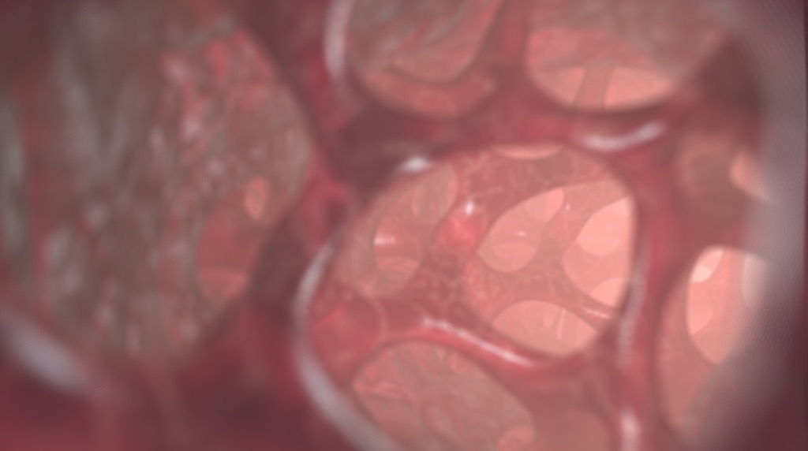
3D-Kernel Foveated Rendering for Light Fields
IEEE Transactions on Visualization and Computer Graphics (TVCG)
Xiaoxu Meng¹, Ruofei Du², Joseph F. JaJa¹ and Amitabh Varshney¹
¹University of Maryland, College Park ²Google LLC
Notes:
Then I present an efficient algorithm to visualize 4D light fields with 3D-kernel foveated rendering. We have developed a perceptual model for foveated light fields by extending the KFR for the rendering of 3D meshes. On datasets of high-resolution microscopic light fields, we observe 3.47X−7.28X speedup in light field rendering with minimal perceptual loss of detail.

Slide 2
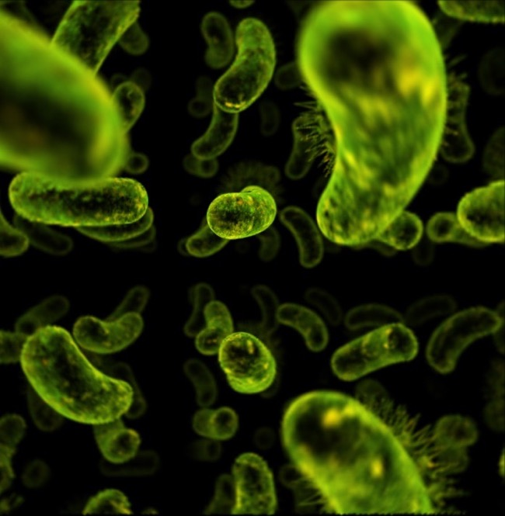
Content
Motivation
Foveated Rendering
Our Approach
User Study
Rendering Acceleration
Notes:
Well, why are we interested in light field?

Slide 3

Light Field $L(u,v,s,t)$
uv - camera plane
st - focal plane
Notes:
With a light field, we can generate new views from arbitrary camera positions without depth information or feature matching. It’s very convenient.

Slide 4
Light Field $L(u,v,s,t)$
uv - camera plane
st - focal plane

Slide 5
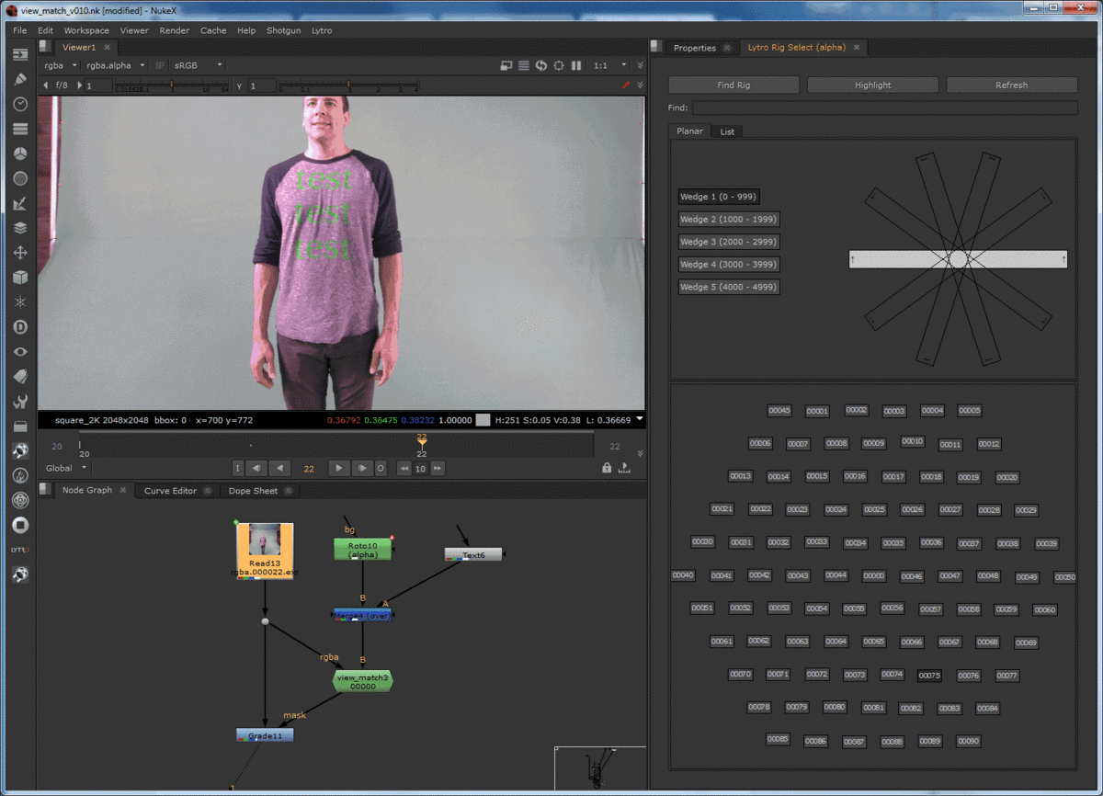
Notes:
Light field is defined as the radiance along rays in an empty space.
To create a light field, views must be obtained for a large collection of viewpoints. We can create a camera array as shown in the video to capture a light field.

Slide 6
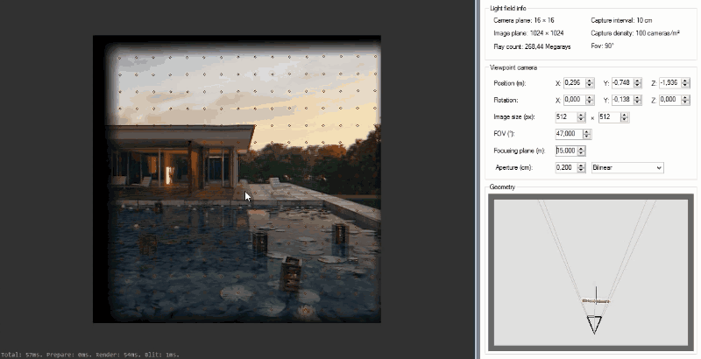
Notes:
With a light field, we can generate new views from arbitrary camera positions without depth information or feature matching.

Slide 7
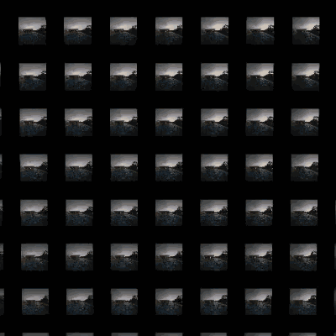
Notes:
With a light field, we can generate new views from arbitrary camera positions without depth information or feature matching. It’s very convenient.

Slide 8
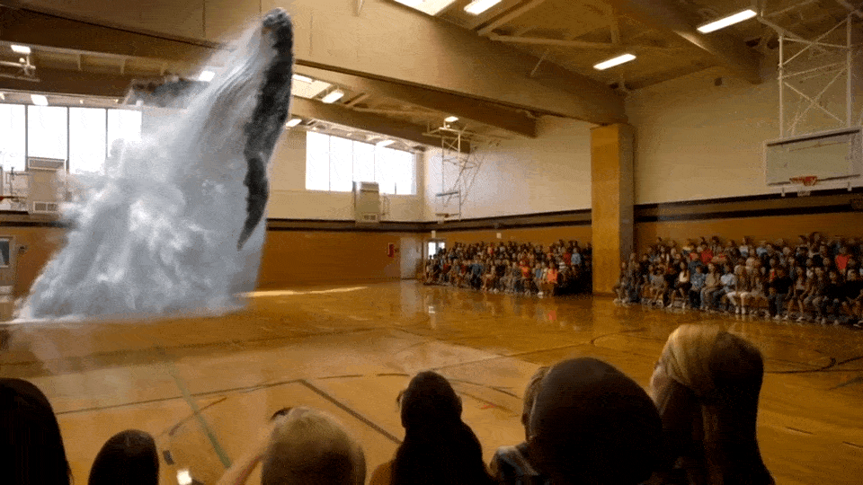
Light field “autostereoscopic”
Notes:
People have been talking about naked-eye 3D or 3D television for a long time.
One way to constitute a 3D television system is to present a light field using technology that maps each sample to the appropriate ray the in physical space, one obtains an autostereoscopic visual effect akin to viewing the original scene.

Slide 9
a light field captured by photographing a speck of fluorescent crayon wax through a microscope objective and microlens array
"Since microscopes are inherently orthographic devices,
perspective views represent a new way to look at microscopic specimens." [1]
[1] Marc Levoy, Ren Ng, Andrew Adams, Matthew Footer, and Mark Horowitz. 2006. Light field microscopy. ACM Trans. Graph. 25, 3 (July 2006), 924-934. DOI: https://doi.org/10.1145/1141911.1141976
Notes:
Another application of light field is viewing the microscopy. Since microscopes are inherently orthographic devices, perspective views represent a new way to look at microscopic specimens.

Slide 10
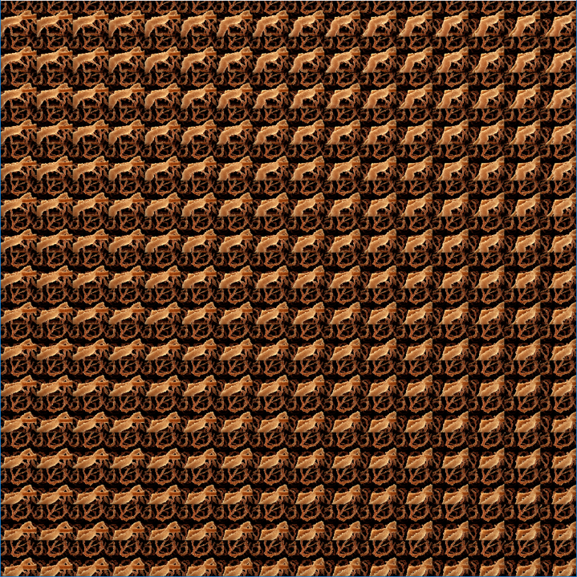
Notes:
Well it seems that light field can be used in many places, but we are not seeing many light field applications in the real world. Why does it happen? For light fields, we have to render all the images from the light field array simultaneously.
For light field microscopy, if each specimen slice is a high-resolution image, it will be very hard to finish it in real time.

Slide 11
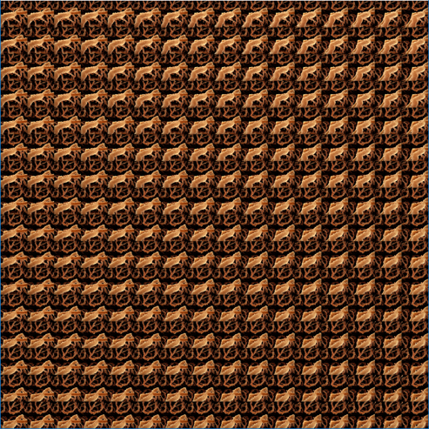
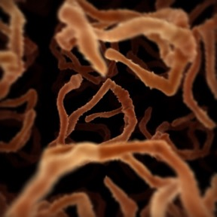
Screen
foveated rendering
fovea
original light field image array
Notes:
When using VR for microscopy, we can apply foveated rendering algorithm to accelerate the rendering process.

Slide 12
Content
Motivation
Foveated Rendering
Our Approach
User Study
Rendering Acceleration
Notes:
Well, why are we interested in light field?

Slide 13
Virtual reality is a challenging workload
Most VR pixels are peripheral
foveal region: the human eye detects significant high-fidelity detail
peripheral region: the human eye detects little high-fidelity detail
Notes:
the resolution of human eyes is the highest resolution in the fovea, and gradually decreasing with the increase of the eccentricity.

Slide 14


Percentage of the Foveal Pixels
96 %
Virtual reality is a challenging workload
Most VR pixels are peripheral
27 %
4 %
* Data from Siggraph 2017, by Anjul Patney, August 2017
Notes:
According to the research in 2017, only 4% percent of the VR pixels are fovea pixels that people can see directly, for the remaining ninety six percent, we are not directly looking at the pixels.

Slide 15
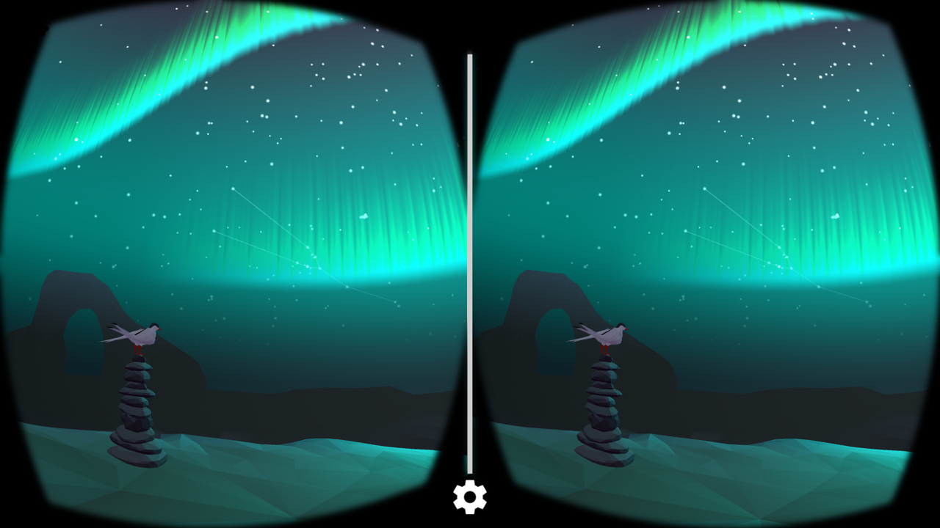
Notes:
So, the idea of foveated rendering,

Slide 16
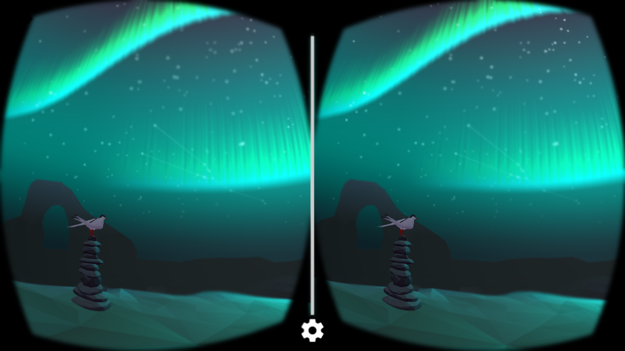
Foveated Rendering
Notes:
Is to render the scene with various pixel density to match the human vision system,
This can potentially reduce the number of pixels rendered by an order of magnitude, or even more.
and we just let the GPU render peripheral region with lower quality and the user of the VR headset cannot notice that. This is called foveated rendering.
As we know, there is always a tradeoff between the rendering quality and the frame rate. If we render the peripheral region with lower quality, we can save the cost of rendering and get higher frame rate.

Slide 17















Log-polar mapping [Araujo and Dias 1996]
$$y$$
$$v$$
$$2π$$
$$(x_{0},y_{0})$$
$$u$$
$$v$$
$$O$$
$$x$$
$$(x_{0},y_{0})$$
$$L$$
$$u$$
Cartesian coordinates
$$(x,y)$$
Log-polar coordinates
$$(u,v)$$
Log-polar Mapping
$$u=\frac{log\sqrt{x^{2}+y^{2}}}{L}∙w$$
$$v=\frac{(arctan\frac{y}{x}+1 [y−0]∙2π)}{2π}∙h$$
$W:screen width H:screen height w:buffer width h:buffer height$
$1 \left[y<0\right]=\left\{\begin{aligned}1 y<0 \\ 0 y>0\end{aligned}\right.$
$L=log\sqrt{W^{2}+H^{2}}$
Notes:
Here is an example.
The left image in cartisian coordinates, while the right image is in log-polar coordinates. Just think of the point (xo,yo) on the screen, we take the log of the distance between the origin and the point as the u, and we take the angle between the line and the x-axis as v.
So the point (xo. yo) is mapped to the log-polar coordinates. We perform this transformation to each point on the screen, so the 2D image in caratesian coordinates is transformed to log-polar coordinates.

Slide 18


Log-polar mapping [Araujo and Dias 1996]
Cartesian coordinates
$$(x,y)$$
Log-polar coordinates
$$(u,v)$$
The closer the point is to the center, the higher pixel density it preserves.
Notes:
You must have noticed that the closer the region is to the origin, the larger it will be in log-polar domain.

Slide 19
Log-polar mapping [Araujo and Dias 1996]
Cartesian coordinates
$$(x,y)$$
Log-polar coordinates
$$(u,v)$$
Points in the peripheral regions are naturally compressed in the log polar domain.
Notes:
And if a ring is far from the origin, it will become small in log-polar coordinates.

Slide 20



Log-polar mapping [Araujo and Dias 1996]
Cartesian coordinates
$$(x,y)$$
Log-polar coordinates
$$(u,v)$$
Cartesian coordinates
$$(x,y)$$
We can recover the image by performing the inverse transformation
Notes:
Then we can recover the 2D image by performing inverse transformation.

Slide 21

Log-polar mapping [Araujo and Dias 1996]
Cartesian coordinates
$$(x,y)$$
Log-polar coordinates
$$(u,v)$$
Cartesian coordinates
$$(x,y)$$
With smaller log-polar buffer, the foveal preserves the original pixel density
while the peripheral regions are compressed.
Notes:
And if we compress the size of the framebuffer, All the regions will be compressed. Because the area of the center region in the log-polar domain is larger than the original frame. We will not get any information loss by performing log-polar transformation. While, the peripheral region in the log-polar domain is greatly compressed. So the information is compressed greatly.

Slide 22
Log-polar mapping [Araujo and Dias 1996]
Cartesian coordinates
$$(x,y)$$
Log-polar coordinates
$$(u,v)$$
Cartesian coordinates
$$(x,y)$$
With smaller log-polar buffer, the foveal preserves the original pixel density
while the peripheral regions are compressed.
Notes:
And if we compress the size of the framebuffer, All the regions will be compressed. Because the area of the center region in the log-polar domain is larger than the original frame. We will not get any information loss by performing log-polar transformation. While, the peripheral region in the log-polar domain is greatly compressed. So the information is compressed greatly.

Slide 23
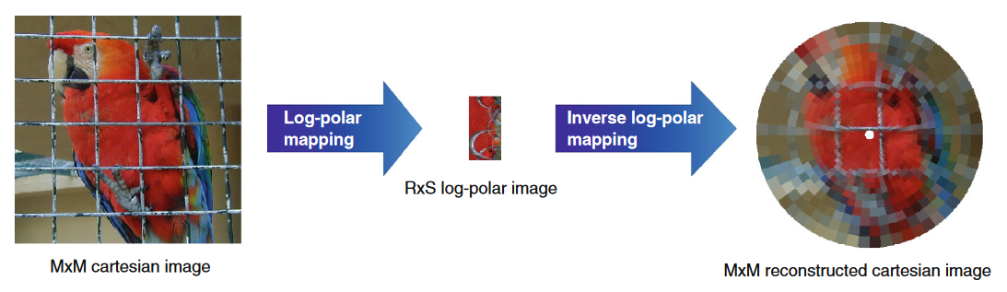
Log-polar Mapping for 2D Image [Antonelli et al. 2015]
Notes:
So when we recover it to Cartesian coordinates,
we will have very low peripheral quality. We can achieve foveation effect by performing log-polar transformation.

Slide 24
Log-polar Mapping for 2D Image
What if we directly render in the log-polar domain to reduce the rendering cost?
How to improve the quality in the peripheral regions?
Notes:
If we can render render the scene in log-polar domain and then recover it to cartesian coordinates, we can save the rendering cost.
But as you can see, the foveation effect is so strong that no one can accept the image quality like mosaic in VR.
We must try to do something to improve the peripheral quality without increasing rendering cost.

Slide 25


Change the Distribution of Pixels (1D)
0
1
0
1
$$K\left(x\right)=x^{2}$$
$$K\left(x\right)=x^{\frac{1}{2}}$$
0
1

Slide 26














Kernel Log-polar Mapping
$$y$$
$$K\left(x\right)=x$$
$$K\left(x\right)=x^{2}$$
$$K\left(x\right)=x^{3}$$
Image in
Cartesian Coordinates
$$x$$
$$K\left(x\right)=\frac{e^{x}−1}{e−1}$$
$$K\left(x\right)=sin⁡(\frac{π}{2}x)$$
$$K\left(x\right)=x^{4}$$
Notes:
Changing the distribution of pixels in log-polar domain.
Because the red part in the formula is normalized to [0,1]. Which makes it easy to play with this part. We used some kernel function in this formula, so we can adjust the distribution of the pixels in the log-polar domain.

Slide 27
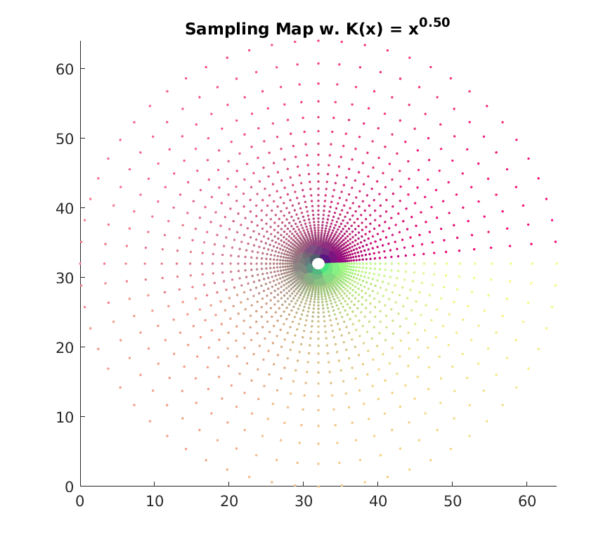
Change the Distribution of Pixels (2D)

Slide 28
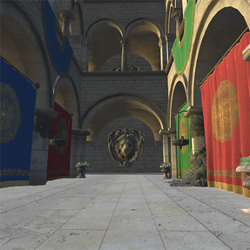
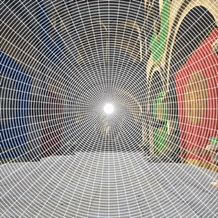
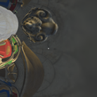






Kernel log-polar coordinates
$$(u,v)$$
Cartesian coordinates
$$(x,y)$$
Cartesian coordinates
$$(x,y)$$
Kernel Log-polar Mapping
$$u=K^{−1}\left(\frac{log\sqrt{x^{2}+y^{2}}}{L}\right)∙w$$
$$v=\frac{(arctan\frac{y}{x}+1[y−0]∙2π)}{2π}∙h$$
$$x=e^{L∙K(\frac{u}{w})}\cos\left(v∙\frac{2π}{h}\right)$$
$$y=e^{L∙K(\frac{u}{w})}\sin\left(v∙\frac{2π}{h}\right)$$
$W:screen width H:screen height w:buffer width h:buffer height$
$1 \left[y<0\right]=\left\{\begin{aligned}1 y<0 \\ 0 y>0\end{aligned}\right.$
$L=log\sqrt{W^{2}+H^{2}}$
$K\left(x\right)=\sum_{i=0}^{∞}{β_{i}x^{i}}, where\sum_{i=0}^{∞}{β_{i}=1}$

Slide 29
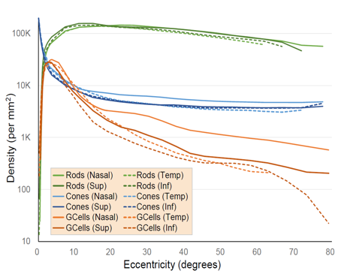
Kernel Foveated Rendering
$$Distribution of pixels \underset{→}{mimic} Distribution of photoreceptors in the human retina$$
Notes:
By doing this, we transform the log-polar image processing to
Kernel log polar image processing
We want to use kernel log polar transformation to let the distribution of pixels mimic the distribution of photoreceptors in the human retina.

Slide 30




$$w$$
$$W$$
$$W$$
Kernel log-polar Mapping
Define buffer parameter σ
$$σ=\frac{W}{w}$$
Notes:
We can parameterize the kernel log-polar transformation with two parameters. The first one is buffer parameter sigma, which is the ratio between the width of the screen and the width of the framebuffer.

Slide 31
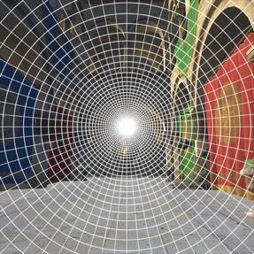



Result of log-polar
$$(K\left(x\right)=x)$$
Result of kernel log-polar $(K\left(x\right)=x^{4})$
Kernel log-polar Mapping
Define buffer parameter σ
$$σ=\frac{W}{w}$$
Define kernel function parameter α
$$K\left(x\right)=x^{α}$$
Notes:
We use the K(x) equals x to the power of alpha as our kernel function.
So the second parameter is the kernel parameter alpha, which allow us to change the distribution of pixels.

Slide 32

Buffer parameter
$$σ$$
Notes:
Firstly, let’s take a look at the image effect with different buffer parameter sigma.

Slide 33
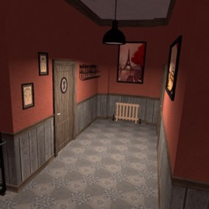
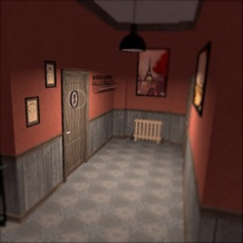
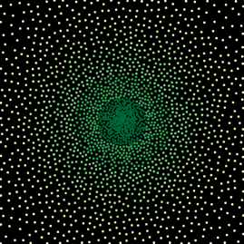
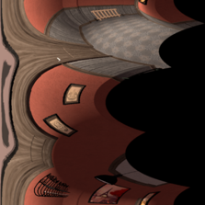

Original Frame
Buffer
Screen
Sample Map
$$σ = 1.2$$

Slide 34
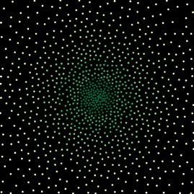


Original Frame
Buffer
Screen
Sample Map
$$σ = 1.7$$

Slide 35
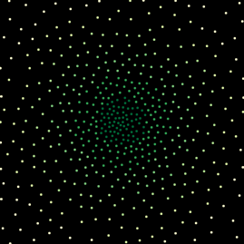


Original Frame
Buffer
Screen
Sample Map
$$σ = 2.4$$

Slide 36












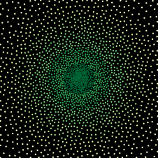
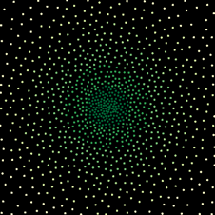
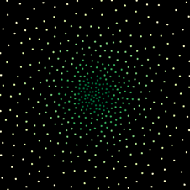



$$σ = 1.2$$
$$σ = 1.7$$
$$σ = 2.4$$
Fovea
Fovea
Fovea
Notes:
By increasing sigma, we reduce the size of the framebuffer.
From the sample map, we can notice that the total number of samples is reduced. But the trend of the density remain the same.
For the first zoomed in view, we can notice that the fovea region are all of very good quality.
For the second one and the third one, we can notice that for the peripheral region, the resolution becomes lower with the increase of the sigma.
Also we are getting artifacts when sigma is very large.
Our goal is to render fewer pixels, so we want to find the largest alpha which has acceptable peripheral detail.

Slide 37

kernel function parameter
$$α$$
Notes:
Then let’s take a look at the alpha.

Slide 38
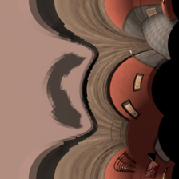

Original Frame
Buffer
Screen
Sample Map
$$α = 1$$

Slide 39

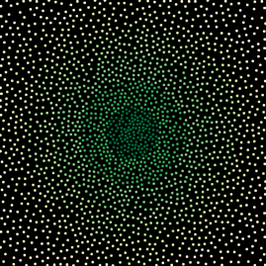


Original Frame
Buffer
Screen
Sample Map
$$α = 4$$

Slide 40

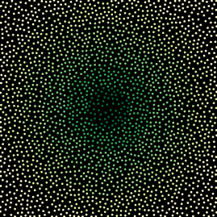
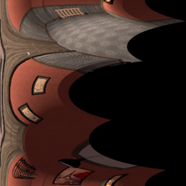

Original Frame
Buffer
Screen
Sample Map
$$α = 6$$

Slide 41












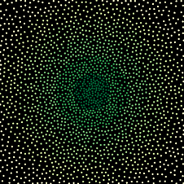
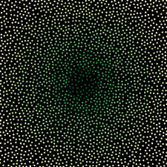



$$α = 1$$
$$α = 4$$
$$α = 6$$
Fovea
Fovea
Fovea
Notes:
By increasing alpha, we change the pixel distribution of the whole image.
From the sample map, we can notice that the total number of samples are the same for the three images. But pixels distribution changes from concentrating on the center to concentrating on the peripheral region.
For the first zoomed in views, we can notice that with fewer and fewer pixels on the fovea, we gradually lose the detail. But the peripheral objects becomes more clear.
Remember we don’t want to experience the image quality like mosaic,
So our goal is to find the laregest alpha which improve the quality of peripheral region and keeps the fovea detail.

Slide 42






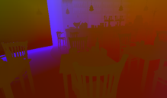
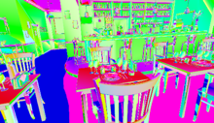
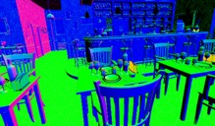

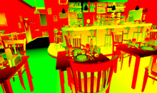
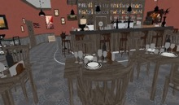
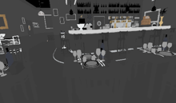
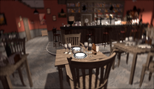

G-buffer
Kernel log-polar transformation
LP-buffer
($σ = 3.0$)
Shading &
internal anti-aliasing
World position
Bit tangent
Normal
Inverse kernel
log-polar transformation
& post anti-aliasing
Screen
Texture coordinates
Albedo map
Roughness, ambient, and refraction maps
Notes:
We implement the two pass foveated rendering pipeline with deferred shading.
In the first pass, we compute the kernel log polar transformation of the G-buffer and render to a reduced resolution buffer.
In the second pass, we carry out the inverse log-polar transformation and perform anti-aliasing to map the reduced resolution rendering to the full resolution screen.

Slide 43
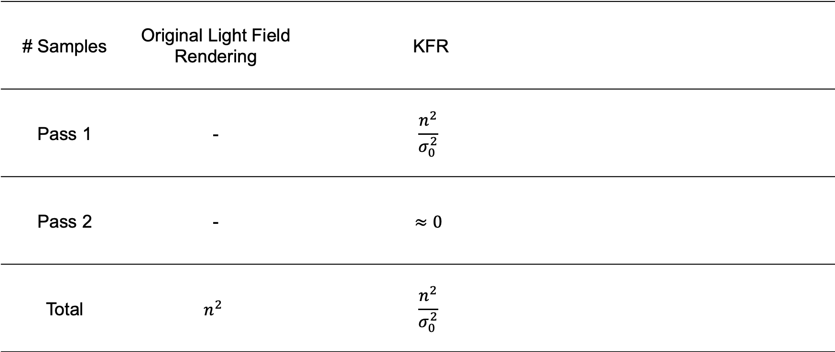
Sampling Rate Comparison between Different Rendering Approaches
# Samples | Original Light Field Rendering | KFR
Pass 1 | - | $$\frac{n^{2}}{σ_{0}^{2}}$$
Pass 2 | - | $$≈0$$
Total | $$n^{2}$$ | $$\frac{n^{2}}{σ_{0}^{2}}$$
Display resolution is $n×n$
Notes:
Theoretical speedup

Slide 44
Content
Motivation
Foveated Rendering
Our Approach
User Study
Rendering Acceleration
Notes:
Our approach

Slide 45
Screen
Better
Than
foveated rendering
fovea
original light field image array
Notes:
but now we are viewing the light field, we can surely do something more than only KFR

Slide 46
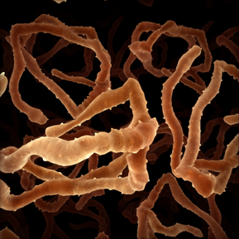
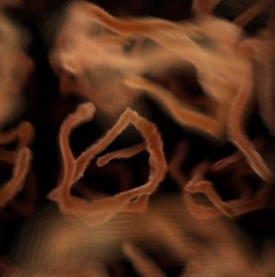

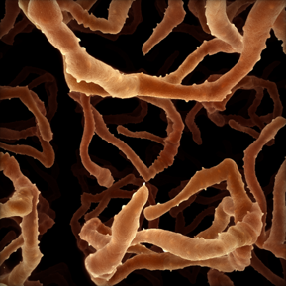

Screen
LP - buffers
fovea
$$σ=σ_{1}$$
recovered visualization of
the light field microscopy
original light field image array
Notes:
Let’s take a look at the image array.
The viewpoints for the slices in the camera array are different
Suppose we want to focus on the tip of this tissue,
The focus position is located at the center for the slice with a medium view position.
And the focus position is located at the periphery for the slice at the corner.

Slide 47
Screen
LP - buffers
fovea
$$σ=σ_{1}$$
recovered visualization of
the light field microscopy
original light field image array
Notes:
Foveation level is determined by the distance between coordinate and the gaze position.
For some of the slices with central view position far from the gaze position, the far peripheral pixels may be not important at all.
So we try to use different foveation parameters for different slices in the light field image array.

Slide 48


3D LP - buffers
$$σ=σ_{0}$$
Screen
fovea
recovered visualization of
the light field microscopy
original light field image array
Notes:
For the slices with central view position near to the gaze position, we use a large framebuffer in the kernel log-polar transformation.
So the sigma is small.

Slide 49


3D LP - buffers
$$σ=σ_{0}$$
Screen
fovea
$$σ=σ_{1}$$
recovered visualization of
the light field microscopy
original light field image array
Notes:
For the slices with a larger distance between central camera position and the gaze position,
we use a smaller framebuffer in the kernel log-polar transformation.
So the sigma one is larger than sigma zero.

Slide 50



3D kernel log-polar transformation with different $σ$ for different frames
sum up the frames with the same$σ$ into one texture
inverse log-polar transformation and post-anti-aliasing
3D LP - buffers
$$σ=σ_{0}$$
Screen
fovea
$$σ=σ_{1}$$
……
……
$$σ=σ_{1}$$
recovered visualization of
the light field microscopy
with speedup of 7.3x compared with
original light field microscopy
original light field image array
transformed image sub-arrays in kernel log-polar coordinates
transformed average image
in kernel log-polar coordinates
Notes:
In a similar way, we crop the light field camera array into different regions and apply different sigmas for the slices.

Slide 51

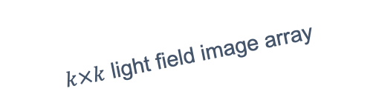
foveal region $d<r_{0}$ $σ_{0}$ $k_{0}$ frames
peripheral region 1 $r_{0}≤d<r_{1}$ $σ_{1}$ $k_{1}$ frames
peripheral region 2 $r_{1}≤d<r_{2}$ $σ_{2}$ $k_{2}$ frames
……
……
……
……
peripheral region N $r_{N−1}≤d<r_{N}$ $σ_{N}$ $k_{N}$ frames
$k×k$ light field image array
$$k×k=k_{0}+k_{1}+k_{2}+k_{N}$$
Notes:
For this light field with dimension of k by k,
we represent the number of frames in each region as k0, k1, k2…,
the sum of the k0, k1, k2 to kn is equal to k square.

Slide 52
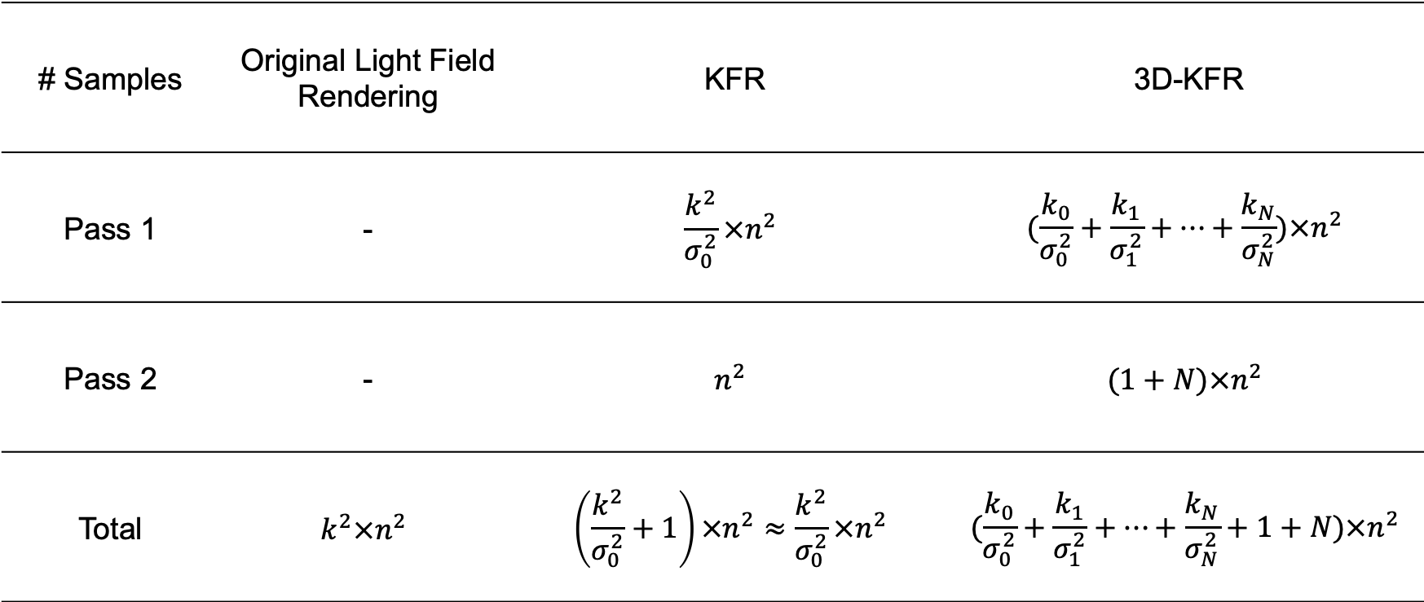

Sampling Rate Comparison between Different Rendering Approaches
# Samples | Original Light Field Rendering | KFR | 3D-KFR
Pass 1 | - | $$\frac{k^{2}}{σ_{0}^{2}}×n^{2}$$ | $$(\frac{k_{0}}{σ_{0}^{2}}+\frac{k_{1}}{σ_{1}^{2}}+…+\frac{k_{N}}{σ_{N}^{2}})×n^{2}$$
Pass 2 | - | $$n^{2}$$ | $$(1+N)×n^{2}$$
Total | $$k^{2}×n^{2}$$ | $$\left(\frac{k^{2}}{σ_{0}^{2}}+1\right)×n^{2}≈\frac{k^{2}}{σ_{0}^{2}}×n^{2}$$ | $$(\frac{k_{0}}{σ_{0}^{2}}+\frac{k_{1}}{σ_{1}^{2}}+…+\frac{k_{N}}{σ_{N}^{2}}+1+N)×n^{2}$$
For a $k×k$ light field with image resolution of $n×n$
$k×k= k_{0}+k_{1}+…+k_{N}$
Display resolution is $n×n$
Notes:
Then we can compare the number of texture sampling with different methods.
For the original light field rendering, we need k square by n square times of texture sampling.
For the KFR, we use parameter sigma 0, and the number of texture sampling in pass1 is …, the number of texture sampling in pass 2 is …
Theoretically 3D-KFR is more efficient than the original light field rendering.

Slide 53
Content
Motivation
Our Approach
User Study
Rendering Acceleration
Notes:
To ensure that the 3D-KFR has good visual effect, we conduct a user study to find the optimum sigmas.

Slide 54



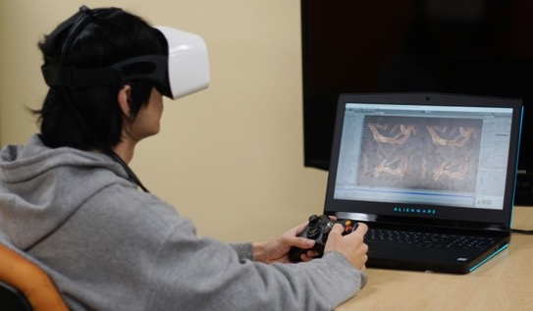




Resolution: $2560×1440$
Field of view: up to 100 degrees
accept
reject
$σ∈\left[1.2, 3.6\right]$ step size: 0.2
Notes:
The setting up of the user study is the same with that of the KFR user study. We used a FOVE headset and an XBOX controller in the user study.

Slide 55

Pair Test
1
Ground Truth
Choose a score for the difference
between the two renderings?
2
Foveated Rendering
1
2
3
4
5
3
Evaluation
$$σ$$ | 1.2 | 1.4 | … | 2.8 | 3.0 | 2.8 | … | 1.4 | 1.2
Notes:
We have 3 separate tests. The first one is the pair test.
We show the participant the foveated scene and the full-resolution scene in random order, then let the user choose whether they feel the two scenes are the same using the XBOX controller.
The user can score the image from 5 to 1. 5 represents totally the same and 1 represents totally different.
The sigma parameter monotone increases from 1.2 – 3.9, then decrease.

Slide 56
Result – Pair Test
Are the regular rendering and the foveated rendering identical?
Notes:
Here’s the result of our pair test.
We calculated the percentage that the user gives score 4 and 5 for the foveated image.
Comparing different sigma, we find that the percentage of the same visual effect decreases with the increase of sigma, which meets our expectation.
we use a threshold of 90% and choose sigma equals 2.4 as our desired parameter.

Slide 57
Random Test
1
Ground Truth
Choose a score for the difference
between the two renderings?
2
Foveated Rendering
1
2
3
4
5
3
Evaluation
Shuffled
$$σ$$ | 2.6 | 1.4 | … | 2.0 | 3.0 | 1.8 | … | 2.2 | 1.6
Notes:
The second one is the random test. The procedure is the same with that of the pair test.
But the sigma are shuffled in this test.

Slide 58
Result – Random Test
Are the regular rendering and the foveated rendering identical?
Notes:
Here’s the result of our random test.
We calculated the percentage that the user gives score 4 and 5 for the foveated image.
we use a threshold of 90% and choose sigma equals 2.6 as our desired parameter.

Slide 59

Slider Test
1
Ground Truth
2
Foveated Rendering
1.2
$$σ$$
3.0
Notes:
In the slider test, we allow the user to look at the full resolution light field firstly, then the user can slide the foveation parameter from 3.0 to 1.2 until they feel the foveated is the same with the full resolution one.

Slide 60
Result – Slider Test
Are the regular rendering and the foveated rendering identical?

Slide 61
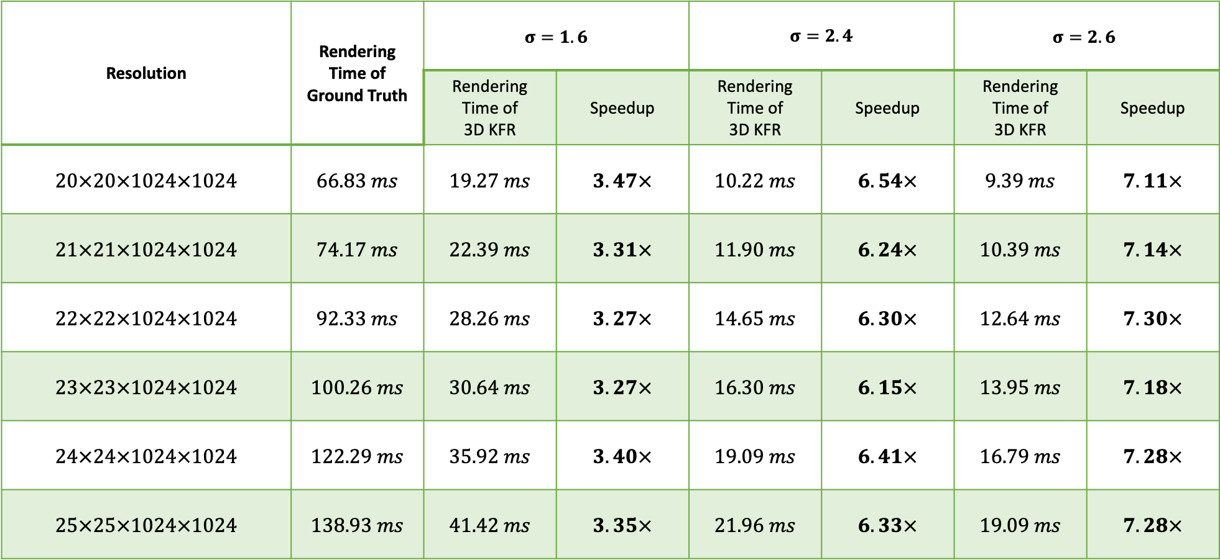
Rendering Acceleration
Resolution | Rendering Time of Ground Truth | $$σ=1.6$$ |  | $σ=2.4$ |  | $$σ=2.6$$
 |  | Rendering Time of 3D KFR | Speedup | Rendering Time of 3D KFR | Speedup | Rendering Time of 3D KFR | Speedup
$$20×20×1024×1024$$ | $$66.83 ms$$ | $$19.27 ms$$ | $$3.47×$$ | $$10.22 ms$$ | $$6.54×$$ | $$9.39 ms$$ | $$7.11×$$
$$21×21×1024×1024$$ | $$74.17 ms$$ | $$22.39 ms$$ | $$3.31×$$ | $$11.90 ms$$ | $$6.24×$$ | $$10.39 ms$$ | $$7.14×$$
$$22×22×1024×1024$$ | $$92.33 ms$$ | $$28.26 ms$$ | $$3.27×$$ | $$14.65 ms$$ | $$6.30×$$ | $$12.64 ms$$ | $$7.30×$$
$$23×23×1024×1024$$ | $$100.26 ms$$ | $$30.64 ms$$ | $$3.27×$$ | $$16.30 ms$$ | $$6.15×$$ | $$13.95 ms$$ | $$7.18×$$
$$24×24×1024×1024$$ | $$122.29 ms$$ | $$35.92 ms$$ | $$3.40×$$ | $$19.09 ms$$ | $$6.41×$$ | $$16.79 ms$$ | $$7.28×$$
$$25×25×1024×1024$$ | $$138.93 ms$$ | $$41.42 ms$$ | $$3.35×$$ | $$21.96 ms$$ | $$6.33×$$ | $$19.09 ms$$ | $$7.28×$$
Notes:
We compared the rendering time with different light field dimensions.

Slide 62
















fovea
fovea
fovea
fovea
(a) original light field
(b) 3D-KFR, σ = 1.6
(c) 3D-KFR, σ = 2.4
(d) 3D-KFR, σ = 2.6

Slide 63
















fovea
fovea
fovea
fovea
(a) original light field
(b) 3D-KFR, σ = 1.6
(c) 3D-KFR, σ = 2.4
(d) 3D-KFR, σ = 2.6

Slide 64















fovea
fovea
fovea
fovea
(a) original light field
(b) 3D-KFR, σ = 1.6
(c) 3D-KFR, σ = 2.4
(d) 3D-KFR, σ = 2.6

Slide 65
















fovea
fovea
fovea
fovea
(a) original light field
(b) 3D-KFR, σ = 1.6
(c) 3D-KFR, σ = 2.4
(d) 3D-KFR, σ = 2.6

Slide 66
















fovea
fovea
fovea
fovea
(a) original light field
(b) 3D-KFR, σ = 1.6
(c) 3D-KFR, σ = 2.4
(d) 3D-KFR, σ = 2.6

Slide 67
















fovea
fovea
fovea
fovea
(a) original light field
(b) 3D-KFR, σ = 1.6
(c) 3D-KFR, σ = 2.4
(d) 3D-KFR, σ = 2.6

Slide 68
Summary
3D-Kernel log-polar transformation for light fields
  3.3X - 7.3X speedup
User study
  Determine parameters to maximize perceptual realism and minimize computation
Light field dataset
  Open Source: https://foveation.umiacs.umd.edu/3D_KFR
Notes:
To summarize,
We firstly designed the kernel log-polar mapping algorithm to enable a parameterized trade-off of visual quality and rendering speed,
Then we conducted user studies to identify the kernel foveated rendering parameters to maximize perceptual realism and minimize computation,
Finally, we mapped kernel foveated rendering onto the GPU to achieve speedups of 2.8 times for textured 3D meshes and 3.2X for ray-casting scenes for 4K displays.

