Slide 1





ORC Layout: Adaptive GUI Layout with OR-Constraints
Yue Jiang University of Maryland, College Park
Ruofei Du Google, San Francisco
Christof Lutteroth University of Bath, Bath, United Kingdom
Wolfgang Stuerzlinger SIAT, Simon Fraser University, Vancouver, Canada
】
Notes:
Hello everyone, it’s my pleasure today to present you our ORC layout, which is an adaptive GUI layout with OR-constraints.

Slide 2




Motivation
Need to design different GUI layouts for different screen sizes, orientations, and aspect ratios.
Notes:
Nowadays designers have to create different layouts for different screen sizes and orientations to get desirable results. This makes GUI design more time-consuming. Also, multiple specifications can be hard to maintain and to keep consistent.
In this project, our aim was to develop a technology that can adapt layouts to screens with different sizes, orientations, and aspect ratios based on only one single layout specification.

Slide 3
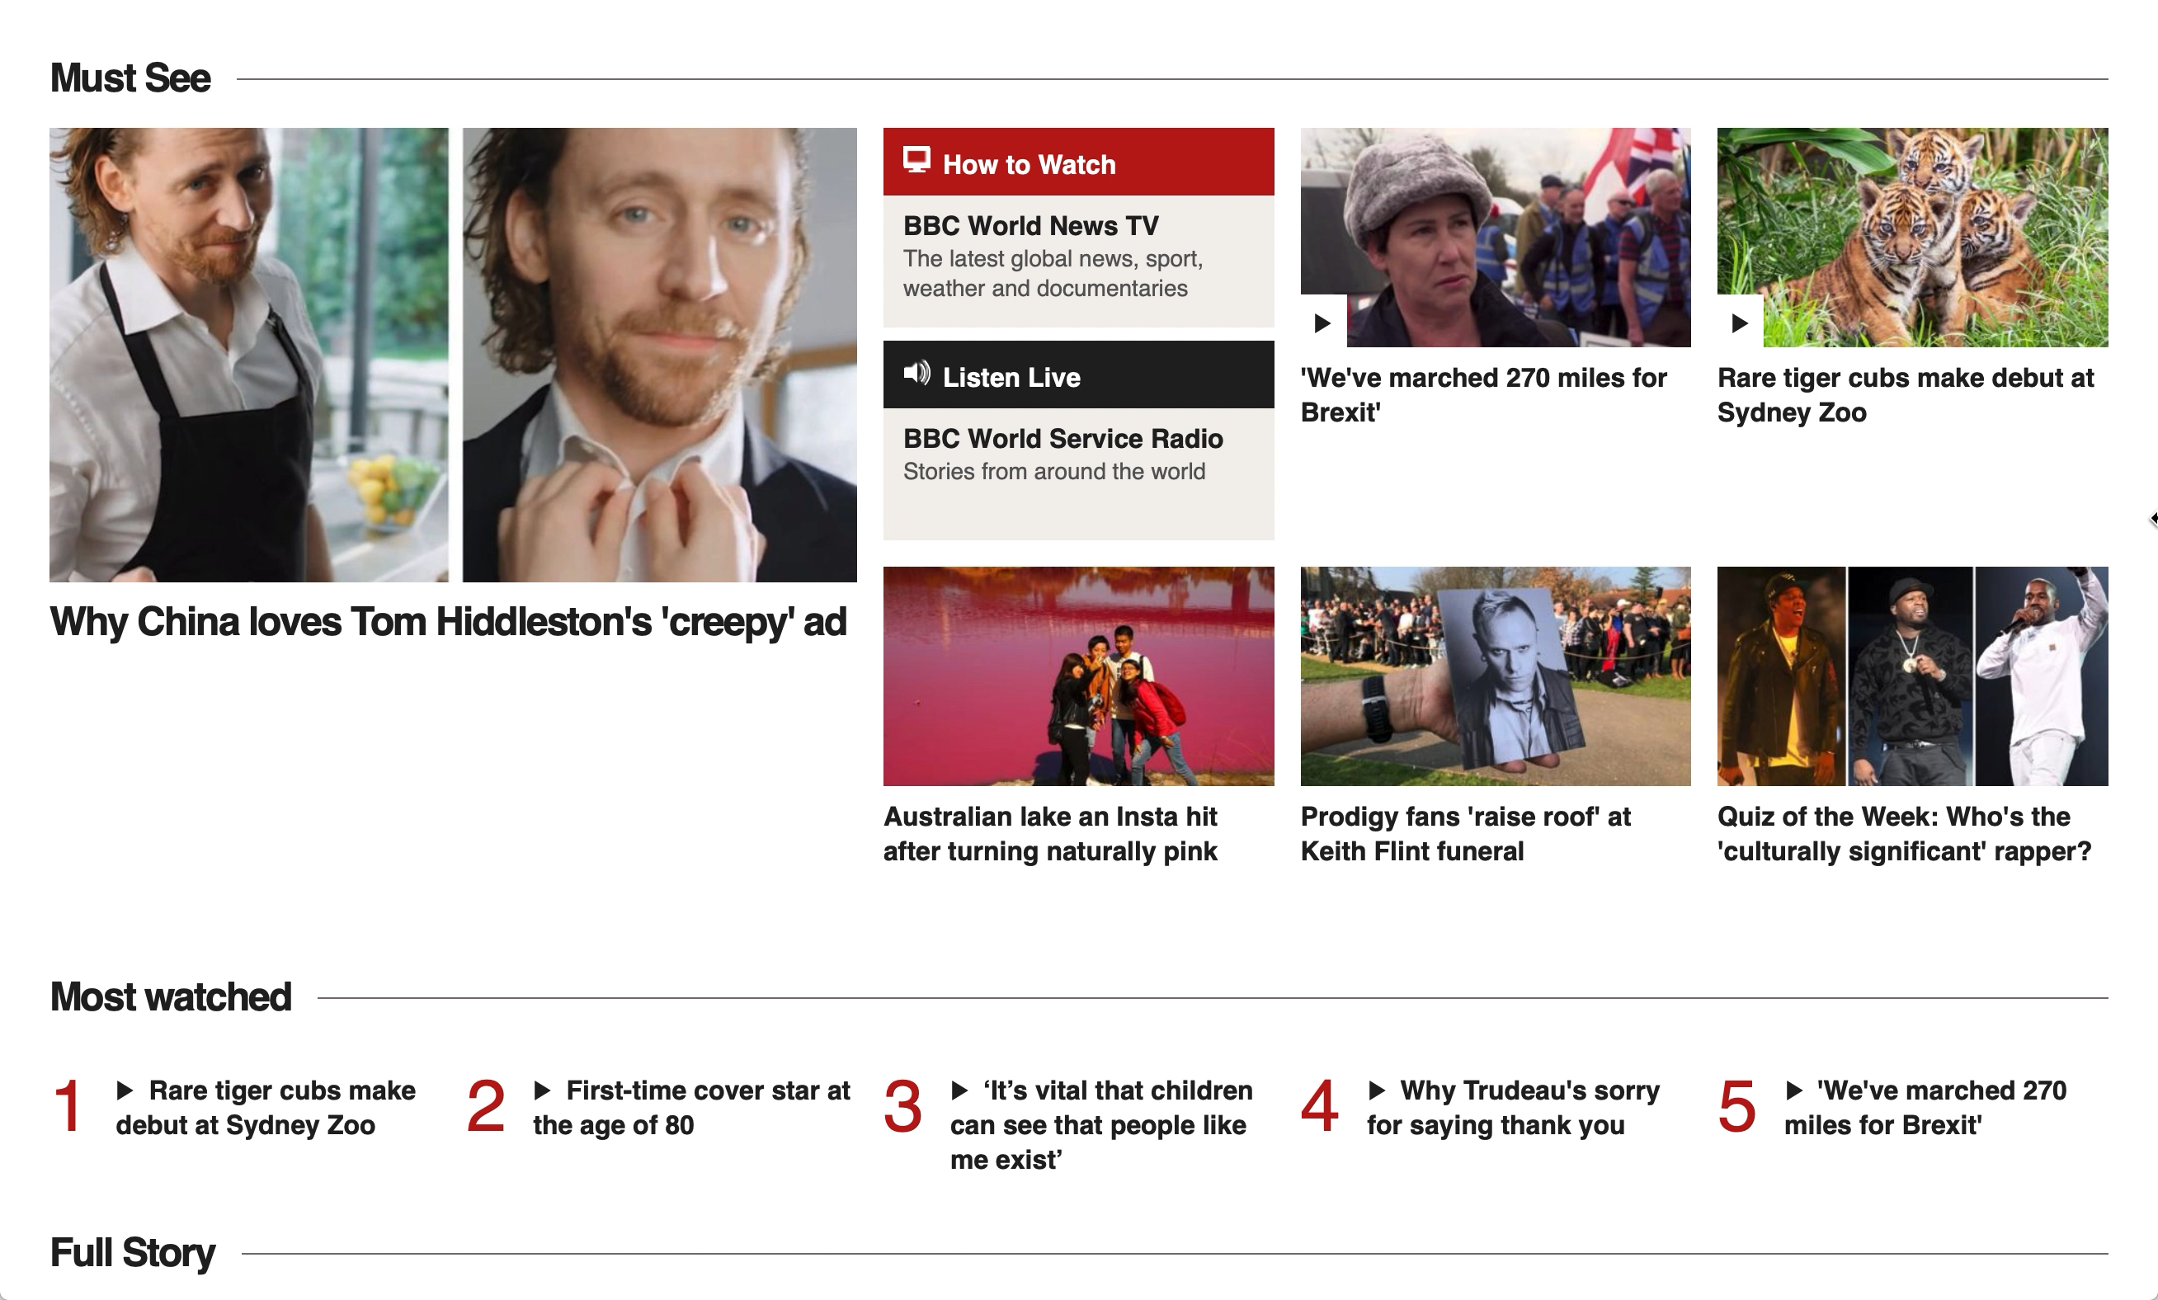
Flow Layout
BBC News
Limitation: cannot restrict positions and relative sizes
Notes:
Flow layout is a very common type of layout. Whenever the screen size changes, items can reflow down the page in the same way we read a document. For example, BBC News uses flow layout. When the screen gets smaller, some news items move to the next row.
^_^
However, flow layouts do not allow designers to restrict the positions and sizes of items relative to each other.

Slide 4
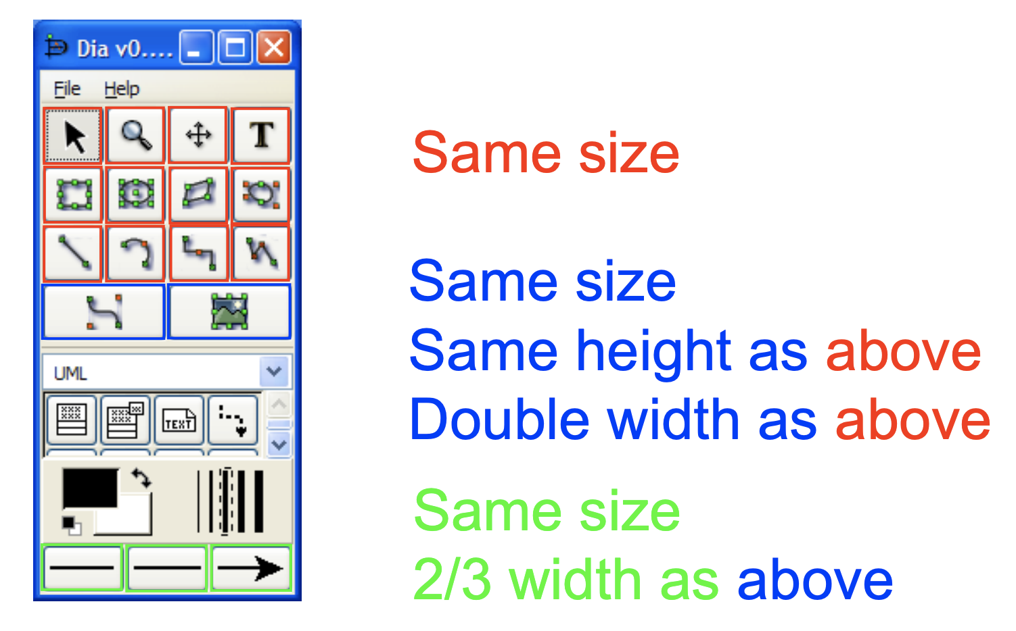


Constraint-based Layout
Constraints:
Same size
Size(Red1) == Size(Red2) == …
Same height as above
Double width as above
Height(Blue) == Height(Red)
Width(Blue) == Width(Red) * 2
Limitations:
Widgets cannot move relative to other ones.
2. Device diversity a long-term challenge.
Notes:
Modern layout models use constraints to align widgets or add other restrictions. For example, ^_^
we can add constraints to make sure all the red widgets have the same size and ^_^
make the blue ones have the same height, but double width as the red ones.
^_^
However, in constraint-based layouts, the layout topology is fixed, which means that once the designer is done with the layout design, widgets will have the fixed positions, so they cannot move around any more. ^_^
Also, despite their flexibility, device diversity is a long-term challenge. Designers have to manually design different layouts for different screen sizes.
For example, if the window is made a little bit larger, it cannot automatically detect that it could fit more widgets into each row.

Slide 5
OR-constrained Layouts (ORC Layouts)
Goal: Unify constraint-based and flow layouts
Approach: OR-constraints
Input:
A set of constraints
Widget min/pref/max sizes
Window size
Output:
Widget sizes
Widget positions
Notes:
Current constraint-based layouts do not support the flow layout functionality.
In this project, our goal was to combine these two types of layouts and get the functionalities and strengths of both!
This can make GUI design more efficient and less error-prone, since designers do not need to manually synchronize changes among different layout specifications for different devices.
To achieve this,
in addition to the standard hard and soft linear constraint system, we propose to include a new type of constraint, ^_^ OR-constraints.
Similar to other constraint-based layouts, ^_^
our inputs are a set of constraints, the sizes of all the widgets, and the window size. ^_^
The outputs are the sizes and positions of those widgets.

Slide 6
OR-Constraints
Constraint1 OR Constraint2 OR Constraint3 …
Soft
Soft
Soft
Hard
Hard Constraints must be satisfied.
Soft Constraints are satisfied if possible. Their importance depends on weights.
Notes:
In a standard hard and soft linear constraint system, ^_^
hard constraints are the ones which must be satisfied, and ^_^
soft constraints can be neglected if it is impossible to satisfy all the constraints in the system. Each soft constraint has a weight to define its priority. Higher weights and thus higher priorities are assigned to more important constraints.
Here we define OR-constraints as a mixture of hard and soft constraints. ^_^
An entire OR-constraint can be seen as a hard constraint, ^_^
while each disjunctive part of it is a soft constraint. Only one single disjunctive part needs to be satisfied to make the OR-constraint true.

Slide 7
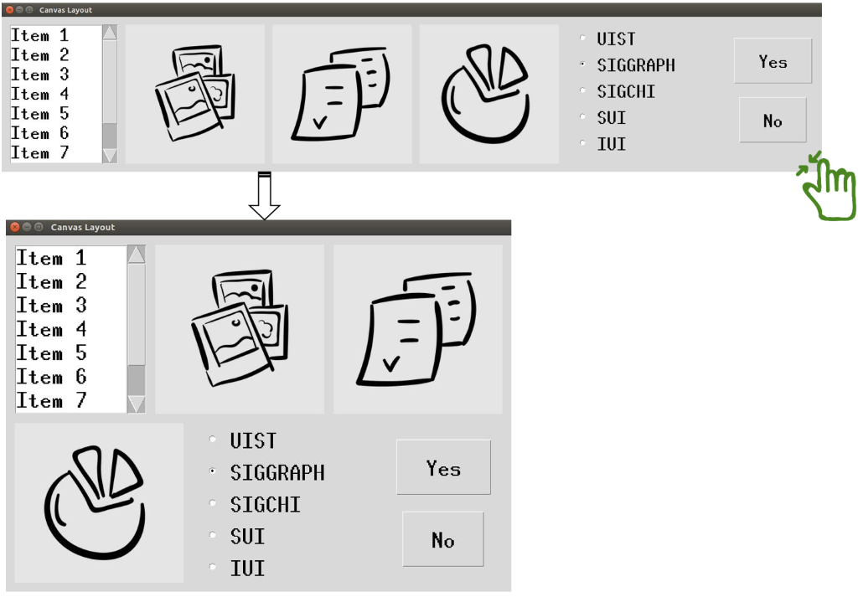
OR-Constraints
to the right of the previous widget
OR
at the beginning of the next row
(larger weight)
(smaller weight)
Notes:
For example, in this horizontal flow layout, we use the OR-constraint ^_^
“To the right of the previous widget OR At the beginning of the next row” between each consecutive pair of widgets to enable ORC-layouts to unify flow layouts and conventional constraint-based layouts.
We likely prefer to place the current widget to the right of the previous one rather than at the beginning of the next row. So in this case, we can attach a larger weight ^_^ to the constraint part “to the right of the previous widget”.
5mins

Slide 8
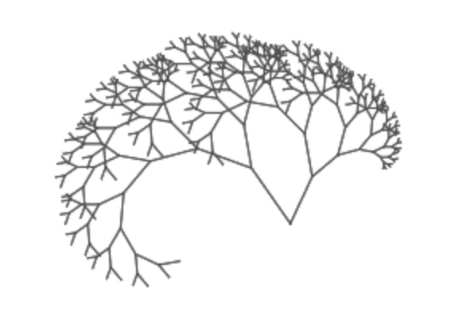
Z3 Solver
OR Constraints → more branches
  Microsoft Z3 Solver:
  Can solve OR-constraints
  Support incremental solving (fast if #widget not too large)
Notes:
Adding OR constraints is like adding more branches to the solution space. In general, it is impossible to try each branch due to the exponential growth of the space. So we need a good solver to help us solve the system quickly. ^_^
Here we use Microsoft Z3 Solver to solve our constraint system. We chose this solver because it can deal with ^_^OR-constraints, and it supports incremental solving. ^_^ So after each update, Z3 solver solves the system based on the previous solution rather than solve the entire system again, which reduces runtimes.
Here we use Microsoft Z3 Solver to solve our constraint system. We chose this solver because it can deal with OR-constraints. It is a long standing winner of SMT competitions, and it supports incremental solving. ^_^ So after each update, Z3 solves the system based on the previous solution rather than solve the entire system again, which reduces runtimes.

Slide 9
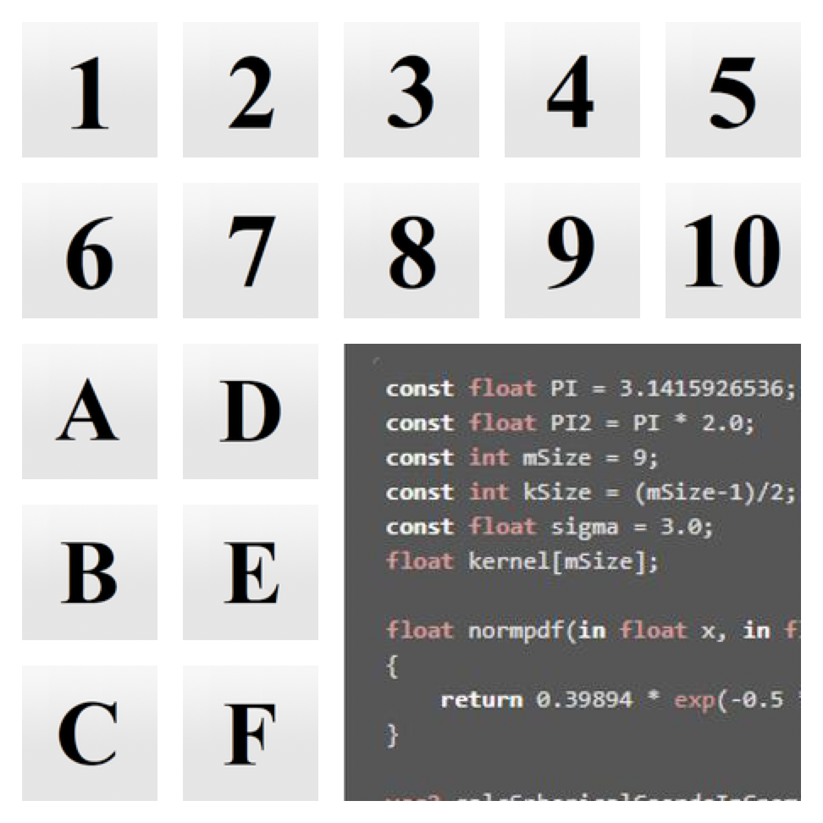
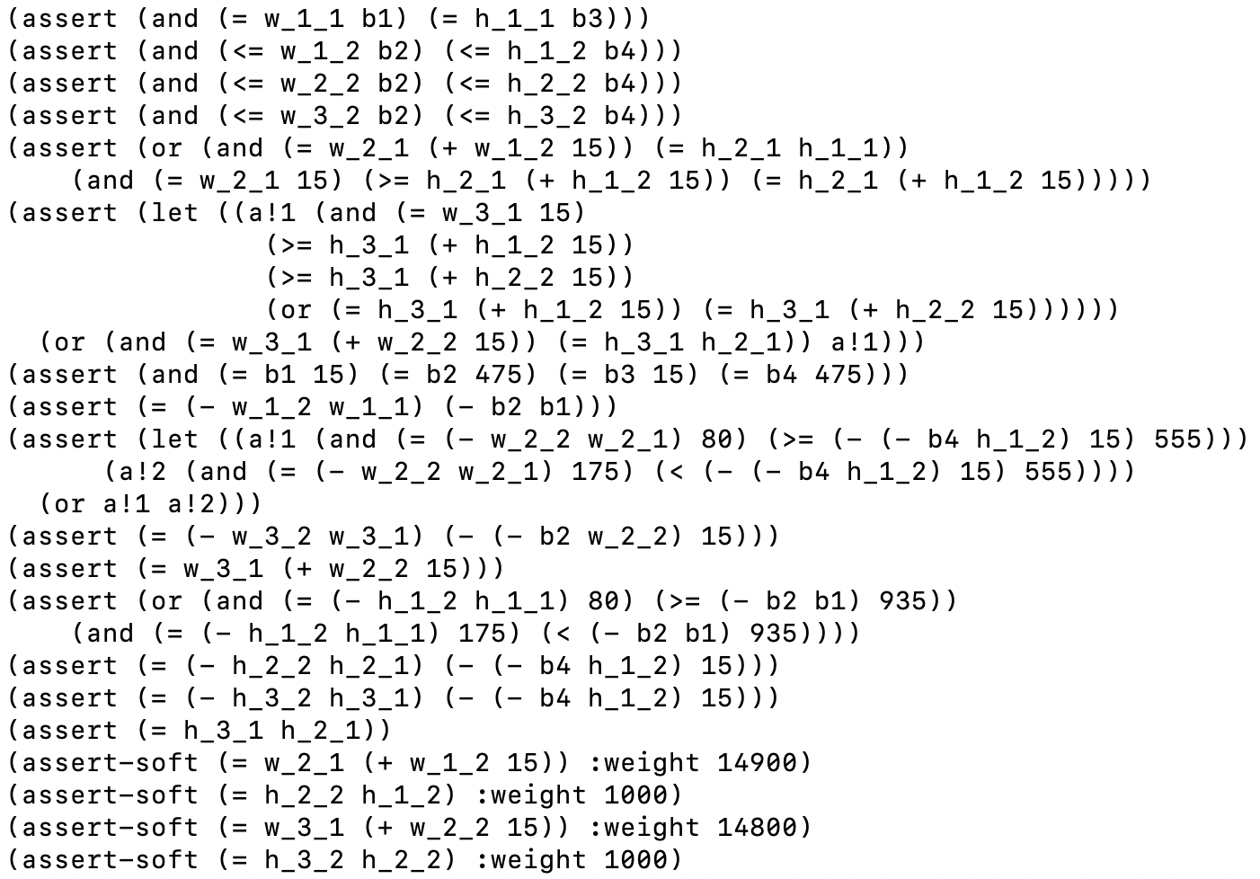
ORC Patterns
Low-level constraints tedious and error prone
Better approach:
Designers → choose a template & modify parameters
System → automatically maintain low-level constraints
Notes:
Editing low-level constraints for a complex layout is tedious and error-prone. ^_^Even a very simple layout requires a large number of constraints. So, instead of letting designers deal with constraints directly, we propose to ^_^ let designers instantiate templates for typical layout patterns, and adjust them by modifying their parameters. ^_^ Our ORC system can then automatically maintain all the low-level constraints. In the following we will have a look at some ORC patterns.

Slide 10
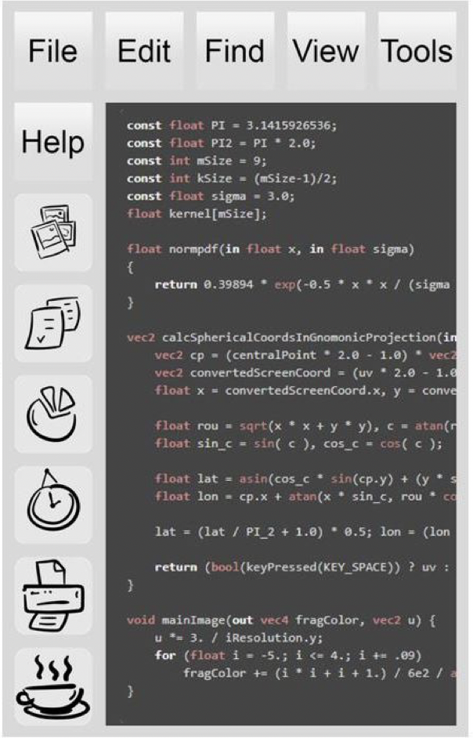
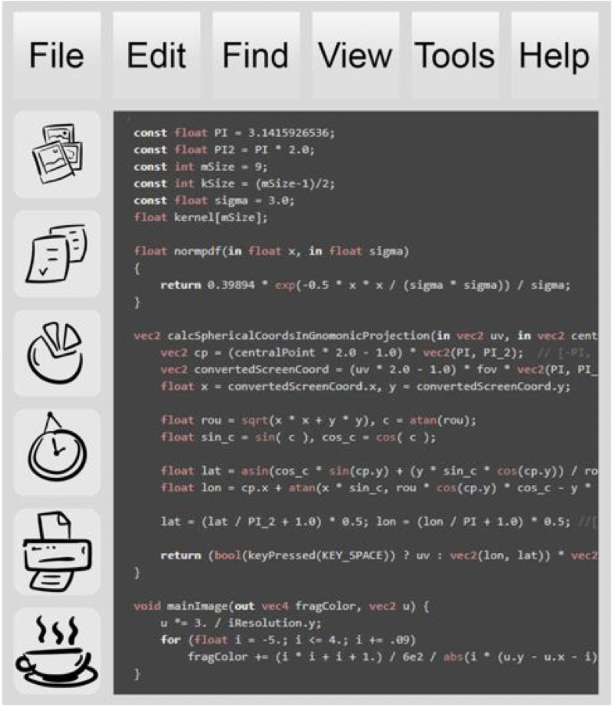

Pattern #1: Connected Layout Pattern
Top toolbar widgets → left toolbar
Notes:
The Connected Layout Pattern connects the sub-layouts so that widgets can move among them.
In this example, the horizontal and vertical toolbars are connected. ^_^ When we have more space in the left toolbar, some widgets in the top toolbar move to the left one.

Slide 11
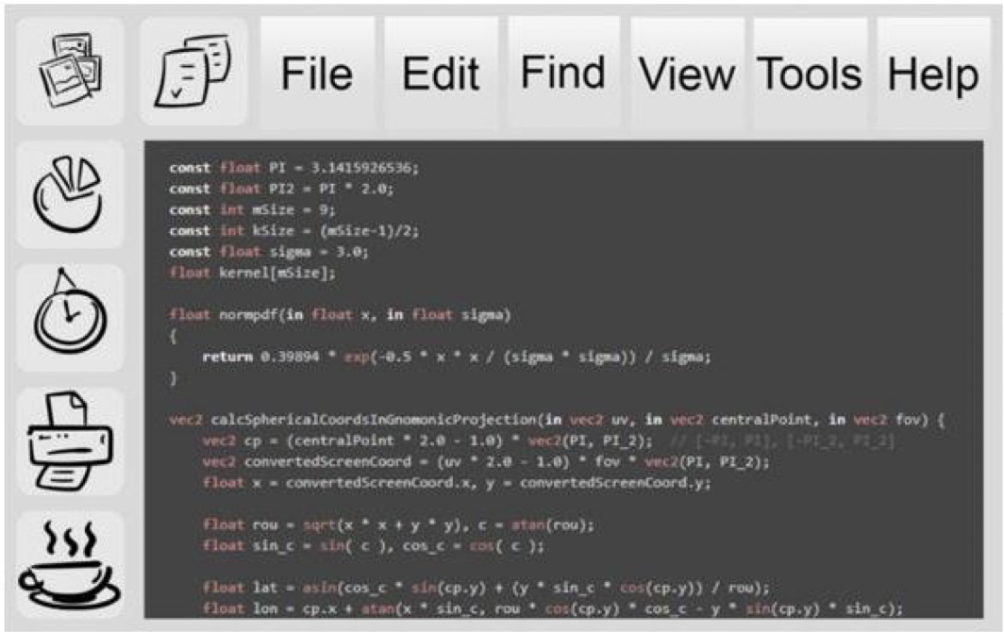
Pattern #1: Connected Layout Pattern
Left toolbar widgets → top toolbar
Notes:
Similarly, when we have more space in the top toolbar, ^_^ some widgets in the left toolbar can move to the top.

Slide 12
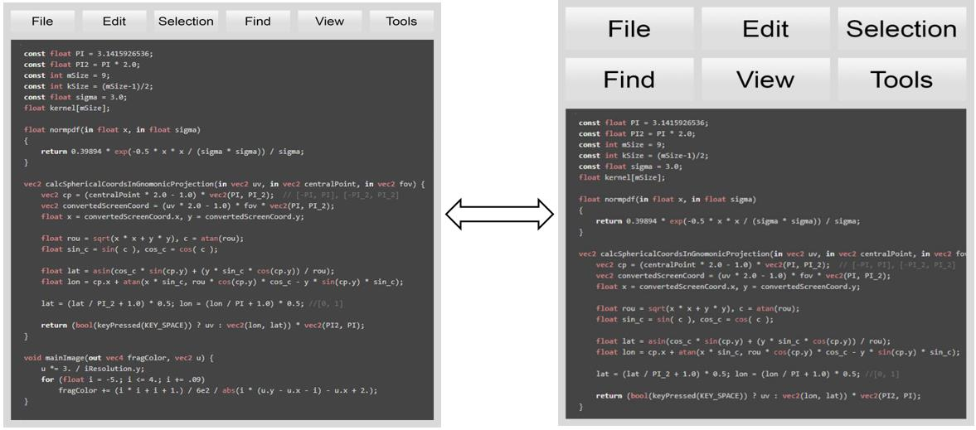

Pattern #2: Balanced Flow Layout Pattern
6 widgets
→ Each row has 1 OR 2 OR 3 OR 6 widgets in the toolbar
Notes:
Conventional flow layouts cannot ensure that the number of rows and columns are balanced with respect to the contained widgets. In the Balanced Flow Layout Pattern, when the widgets in the toolbar are broken into rows, each row can only have one of the predefined numbers of widgets, based on the factors of the number of the widgets in the toolbar.
For example, here we have 6 widgets in the toolbar. ^_^ When the widgets in the toolbar are broken into rows, each row can only have 1, 2, 3 or 6 widgets to balance the rows ^_^ since these numbers are the factors of 6. According to the window size, the top toolbar has a preferred size and number of rows. We give higher weight to the closest balanced result to generate a good layout.

Slide 13
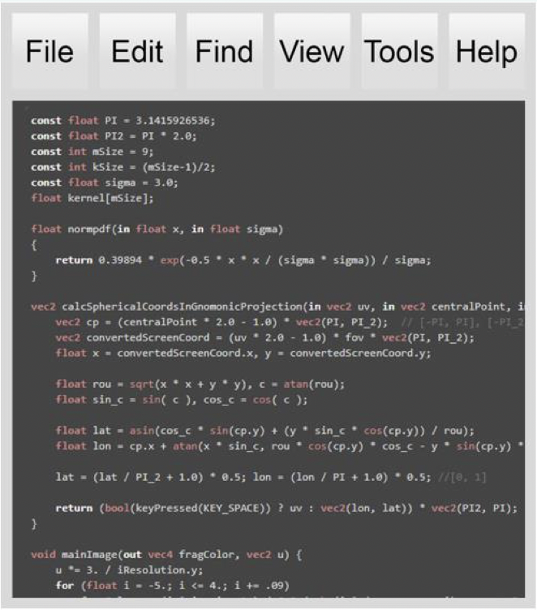
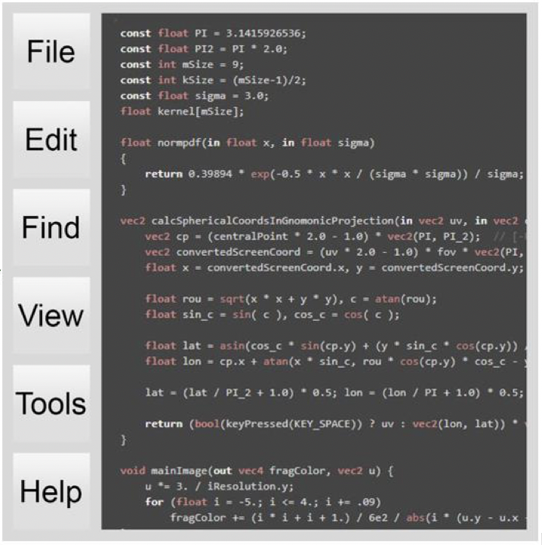
Pattern #3: Alterative Positions Pattern
Top Toolbar
OR
Left Toolbar
(weights depend on which one you prefer)
Notes:
In the Alternative Position Layout Pattern, we can define alternative positions for widgets or sub-layouts with a simple OR-constraint. For example, a top toolbar can move to the left of the window ^_^ or vice versa when the screen size changes, for example, through a device rotation.
If the designer prefers a top toolbar, we can set the top toolbar alternative to have a higher weight ^_^ than the left toolbar in our constraint system.

Slide 14
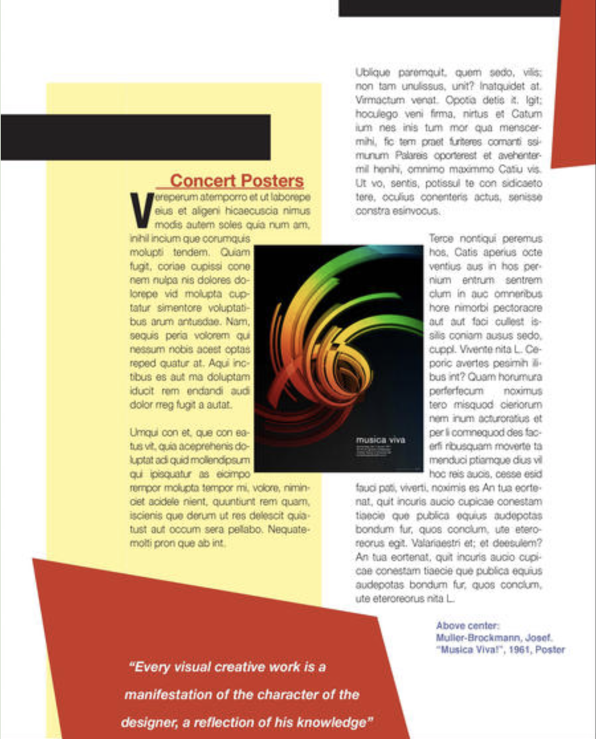

Pattern #4: Flowing Widgets around a Fixed Area
Notes:
ORC layouts can also deal with the case of flowing widgets around a fixed area, like placing a picture on a page of text and flowing text around it. ^_^ This pattern is widely used in document layouts.

Slide 15
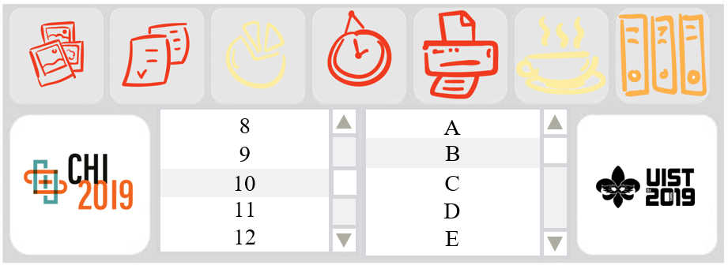

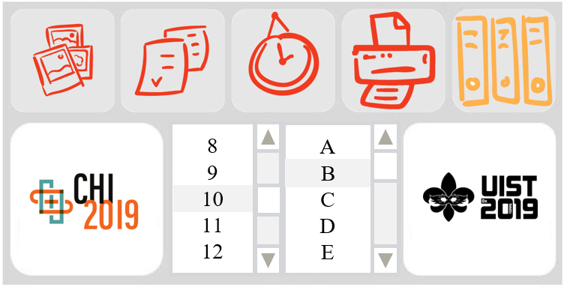

Pattern #5: Optional Layout Pattern
Less important
Notes:
Some widgets can also be made optional. The designer can specify that some menu items, ^_^ such as the ones in yellow here, are less important. So when we change the window size, ^_^ they can disappear as the window shrinks. the shrinking happens based on priority.
10 mins

Slide 16
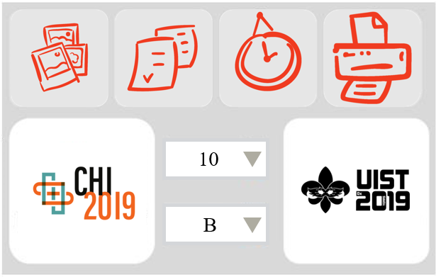
Pattern #6: Alternative Widget Layout Pattern
Notes:
If a window does not have enough space, some widgets can also have alternative representations. For example, ^_^ list boxes can be replaced by option Menus.

Slide 17
Limitations
  Patterns restrict what designers can create.
  Manual ORC specification potentially error-prone.
  Non-interactive solving time for larger number of widgets
Notes:
However, currently, designers can only choose from the patterns we predefined in our system. If what they want does not fit any template in the system, the designers have to touch the constraint system, which is typically tedious and error-prone.
^_^
Through the use of an efficient (SMT) solver, Z3 solver, ORC layout constraint systems with soft, hard and OR-constraints can typically be solved at interactive rates if the number of widgets is not too large.
In the future, a faster solver might be able to solve layouts for large number of widgets.

Slide 18
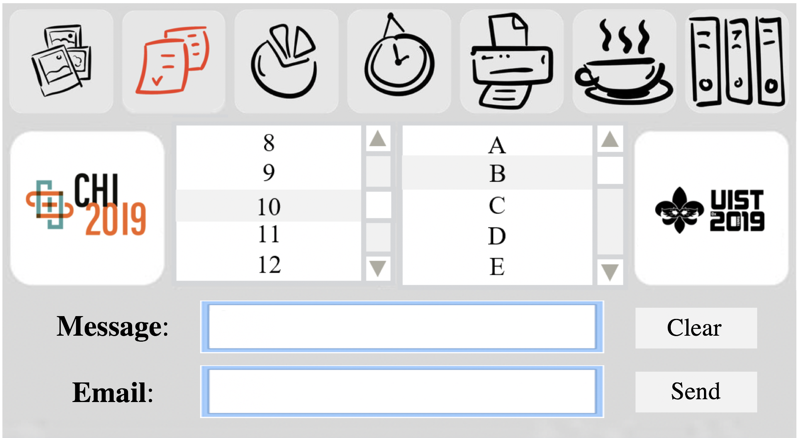
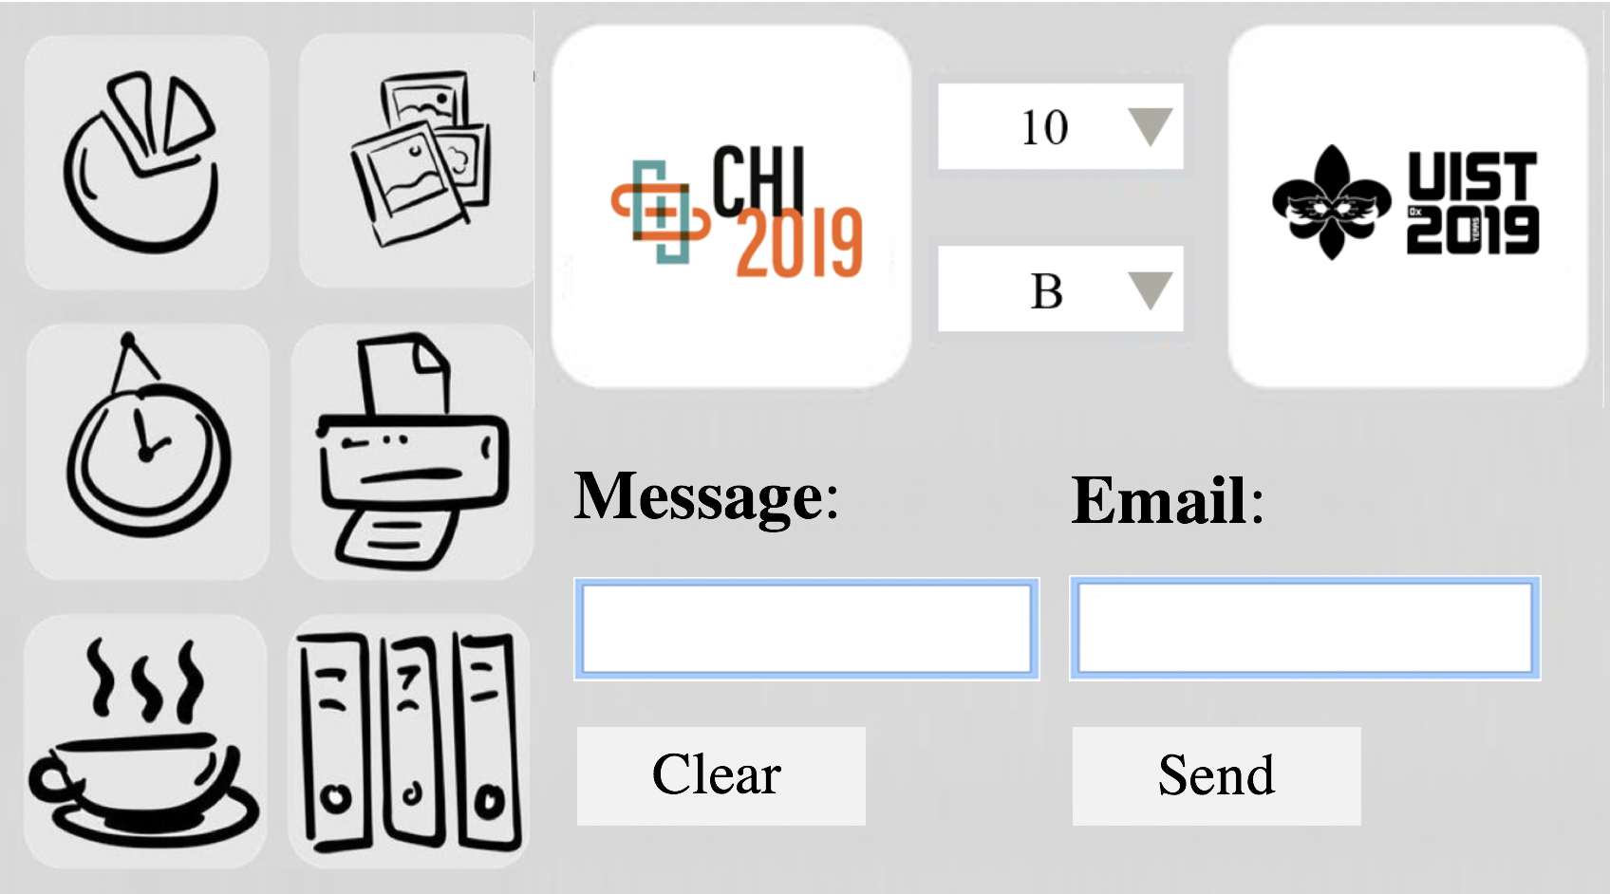


Conclusion
ORC Layouts
  Introduce OR-constraints
  Unify flow & constraint-based layouts
  Enrich GUI layout design space
Notes:
In conclusion, our ORC Layout is a novel GUI layout method that adds OR-constraints to standard constraint-based layout specifications. OR-constraints can unify flow layouts and conventional constraint-based layouts, which opens up many options for layouts that work across screen rotations and cases where conventional constraint-based layouts and flow layouts individually fail.
We envision that our new layout method could be widely applied in many applications including modern web design, document format, and app layout.

Slide 19



Co-authors
Ruofei Du
Christof Lutteroth
Wolfgang Stuerzlinger
Notes:
I would like to wrap up by thanking my co-authors and especially both my advisors on this project, Christof and Wolfgang, who provided a lot of support and encouragement and served as an example for me. I also really appreciate that Wolfgang let me work on this fantastic topic, without ever having seen me.

Slide 20
Thank you!
Yue Jiang: yuejiang@cs.umd.edu
https://cs.umd.edu/~yuejiang
Contributions:
Add OR-constraints to standard hard/soft constraint systems.
Adapt layouts to screens with different screen sizes, orientations, and aspect ratios with only a single specification.
Unify flow & constraint-based layouts.
Yue Jiang†, Ruofei Du†‡, Christof Lutteroth§, and Wolfgang Stuerzlinger¶
†University of Maryland, College Park ‡Google LLC
§University of Bath, Bath, United Kingdom ¶Simon Fraser University, Vancouver, BC, Canada
Notes:
Thank you for listening.

Slide 21
Notes:
Note: We don’t have a very good user interface now, but it is our first step. In the future, we will be able to create a good user interface for people to design, such as to quickly try different patterns.

Slide 22
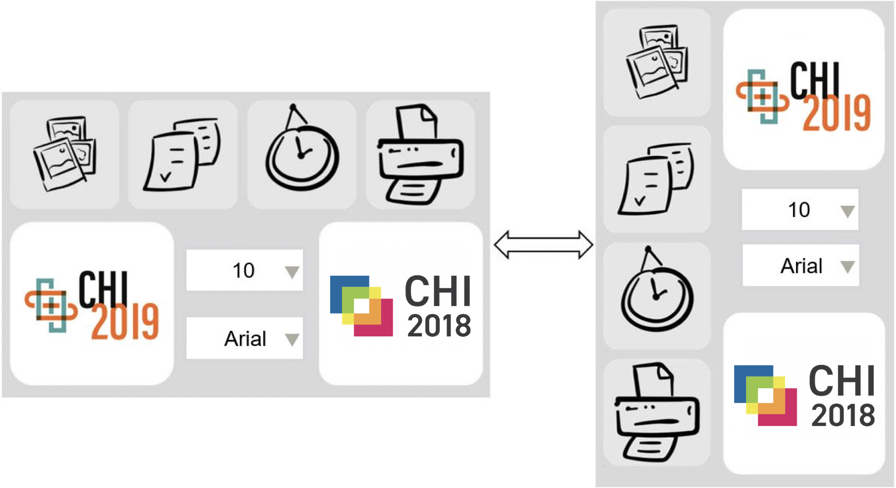
Landscape vs. Portrait
to the right OR at the start of the next row
to the bottom OR at the start of the next column
Notes:
Our OR-constraints enable designers to specify multiple alternatives at the same time. In this example, a top toolbar in the horizonal window can be repositioned automatically to the left when we switch to vertical screen orientation. Then, designers don’t need to design different layouts for different screen orientations. So, with OR-constraints, a single layout specification can support many different screen sizes and aspect ratios.

Slide 23
Flow Layout
BBC News
Limitation: cannot constrain positions and relative sizes
Notes:
Flow layout is a very common type of layout. Whenever the screen size changes, items can reflow down the page in the same way we read a document. For example, BBC News uses flow layout. When the screen gets smaller, some news items move to the next row.
^_^
However, flow layouts do not allow designers to constrain the positions and sizes of items relative to each other.

Slide 24
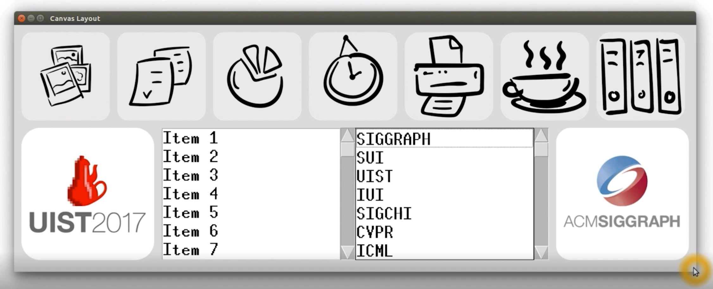
Pattern #5: Optional Layout Pattern &
Pattern #6: Alternative Widget Layout Pattern
Notes:
If a window does not have enough space, some widgets can have alternative representations or can be made optional. In this example, list boxes can be replaced by Option Menus and some widgets in the toolbar are optional.

Slide 25

Pattern #5: Optional Layout Pattern &
Pattern #6: Alternative Widget Layout Pattern
Size(OptionMenu) = 0
(high weight)
OR
Size(ListBox) = 0
(low weight)
Size(ToolbarWidget) != 0
(high weight W)
OR
Size(ToolbarWidget) = 0
(low weight)
W depends on priority
Notes:
In the previous example, Option Menus can replace list boxes. This is done by putting both of them into the layout, next to each other and using an OR-constraint to select one of them to be invisible by giving it a size of 0.
Also, some widgets in the toolbar can be made optional. This functionality can be realized by attaching the OR-constraint “the widget has zero size OR nonzero size” to an optional widgets. We give higher weight to the case that the widget exists. The weight W depends on the priority assigned to each widget. When the window gets smaller, widgets with lower weights disappear before those with higher weights.
[HCI people said these are too hard to follow! Let’s remove it.. Comments: ”All of these things on the left is how you formalize this into an optimization problem. This is what you pass on the solver. You are not expecting users to do this. This is what kind of coding you did. It is not important how you achieve it. “]
Alternative thoughts: The designer would specify that some menu items in yellow here are less important. So when you change the size of the window, they disappear. As the window shrinks, the shrinking happens based on priority and the solver understand that by the way it is formulated.

Slide 26
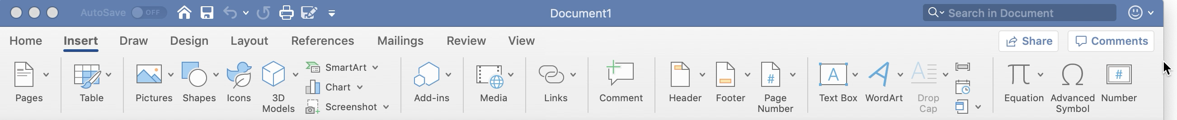
Pattern #5: Optional Layout Pattern &
Pattern #6: Alternative Widget Layout Pattern
Notes:
Such patterns are used, e.g., already by the MS Word ribbon menu, but this functionality is hardcoded.

Slide 27
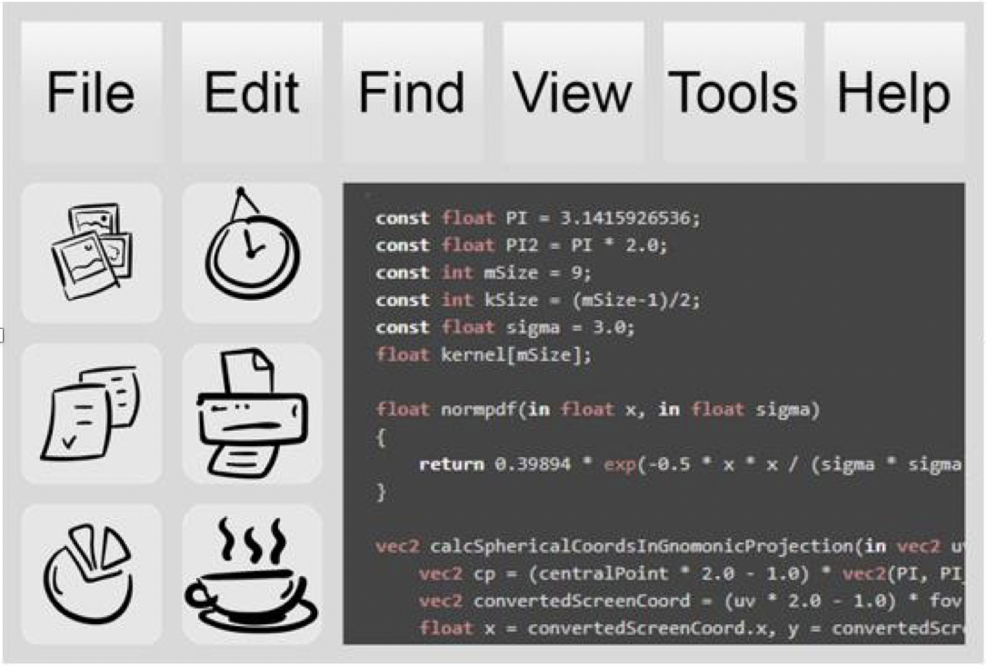
Pattern #1: Cross-cutting Layout Pattern
Size(top toolbar widgets)
== Size(left toolbar widgets)
To the bottom of the previous button
OR
At the beginning of the next column
Notes:
In the Cross-cutting Layout Pattern, the top toolbar is a horizontal flow and the left toolbar is a vertical one. The toolbars can automatically transform into multiple rows or columns as the screen size changes.
In this example, the designers would only need to specify that the buttons in the left toolbar are a vertical flow ^_^, then the system attaches the constraint ”To the bottom of the previous button OR at the beginning of the next column” to all the buttons in the left toolbar and solves the layout automatically.
^_^. ^_^
We can see that when you reduce the height of the window, the left toolbar automatically ^_^ ^_^ transforms into two columns to contain all the widgets in it.
Note: At the moment the slide misses the point of cross-cutting: the main thing here is the cross-cutting constraints (i.e. constraints between two different flow layouts, cross-cutting the usual GUI hierarchy), which ensure that the widgets in the toolbars have sizes consistent with one another (i.e. the same sizes here).

Slide 28
Conclusion and Limitation
ORC Layout:
  OR-constraints
  To unify flow layouts & constraint-based layouts
Limitation:
  Time!
Notes:
In conclusion, our ORC Layout is a novel GUI layout method that adds OR-constraints to standard constraint-based layout specifications. OR-constraints can unify flow layouts and conventional constraint-based layouts, which opens up options for layouts that work across screen rotations and cases where constraint-based layouts and flow layouts individually fail.
#### [HCI people think I should remove this ☹] Through the use of an efficient SMT solver, Z3 solver, ORC layout constraint systems with soft, hard and OR-constraints can typically be solved at interactive rates if the number of widgets is not too large. In the future, we can imagine a faster solver can make it be efficient for even very large number of widgets.
We envision that our new layout method could be widely applied in many applications including modern web design, document format, and app layout.

